Slide 1

Graduate Outcomes Survey
The Class of 2017
Valerie Harvey, HEA
Level 6 and 7 programmes in the technological HE sector

Slide 2


HEA Graduate Outcomes Survey
Updated survey across higher education
  Followed a collaborative 3 year process
  Fully implemented in 2018 (class of 2017 graduates)
  Followed a pilot across 13 THEIs in 2017
Valuable new data
  Includes THEIs
  Includes level 6 and 7
  New database and technical implementation

Slide 3

Survey 2018 (class of 2017)
Short survey, nine months after graduation
First question to all graduates – what is your main activity?
  Employment
  Further study
  Unemployed
  Doing other activities
Some questions about this main activity (max 15)
Then final questions on reflections
Mainly factual questions, very few Likert scales

Slide 4

Results Class of 2017 – entire HE system
58,136 graduates in survey
51% response rate
  57% Universities
  44% Technological Sector
  30% Colleges
Survey sent out electronically with phone call follow up, by the careers offices of HEIs
Data coded and returned to HEA for analysis
Data includes personal and course details of graduates

Slide 5
ALL SECTORS, ALL COHORTS
78% working
14% studying
5% unemployed
4% other

Slide 6
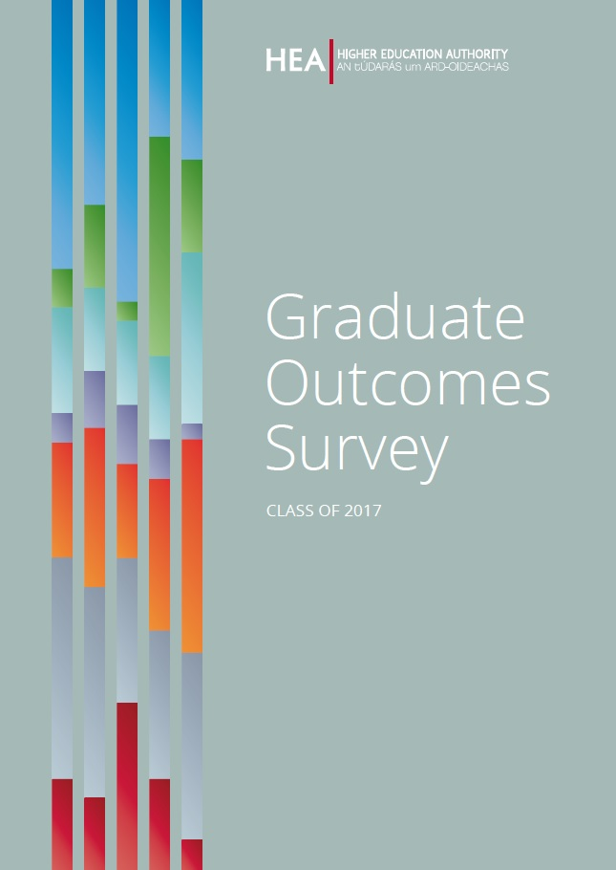
Graduate Survey Report
Breakdowns by
  Sector (Uni/THE/Colleges)
  Mode (FT/PT/remote)
  Gender
  Field of study
Dedicated chapters by level of study (Level 6/7, Hons Degree, PG Taught, PG Research)
Salary Analysis
Special focus chapter

Slide 7

Focus on Level 6 and 7

Slide 8

Graduate Cohort – Levels 6 & 7
Total: 9,602 graduates
  2,471 at level 6 (26%)
  7,131 at level 7 (74%)
57% of graduates were male
  56% at level 6
  58% al level 7
94% of graduates were Irish domiciled
  96% at level 6
  93% at level 7
50% for honours degrees (THEIs)

Slide 9

Graduate Cohort – Mode of Study
23% of graduates at level 6 & 7 studied part-time
Level 6: 37% PT
Level 7: 18% PT
74% of graduates at levels 6 & 7 studied full-time
Level 6: 62% FT
Level 7: 79% FT
Compared with honours degree (THEIs):
93% full-time
6% part-time

Slide 10
Graduate Cohort – Field of Study
 | Level 6 | Level 7 | Total
Business, administration and law | 34% | 20% | 23%
Engineering, manufacturing and construction | 15% | 23% | 21%
Services (hospitality, sports, tourism) | 16% | 15% | 16%
Health and welfare | 13% | 12% | 13%
Information and Communication Technologies (ICTs) | 6% | 10% | 9%
Natural sciences, mathematics and statistics | 7% | 8% | 8%
Arts and humanities | 4% | 5% | 5%
Agriculture, forestry, fisheries and veterinary | 2% | 5% | 4%
Social sciences, journalism and information | 0% | 1% | 1%
Education | 2% | 0% | 1%
Honours Degree THEIs | Honours Degree All HEIs
25% | 21%
13% | 9%
8% | 3%
20% | 18%
8% | 6%
8% | 11%
13% | 19%
2% | 2%
2% | 6%
1% | 5%

Slide 11
Survey Results and Data Note!
In order to capture fully the nature of progression from level 6 to level 7 and onward to level 8, institutes identified those continuing on the ladder system within their institute to a higher level of study with a special identification code.
These graduates did not receive the survey for completion, but their administrative data is stored within the Graduate Outcomes Survey database.

Slide 12
Level 6 – 20% employed
Level 7 – 25% employed
Both levels – 24% employed
Level 6 – 74% further study
Level 7 – 72% further study
Both levels – 73% f. study

Slide 13

Level 6 & 7 graduates in employment
93% employed in Ireland
92% employees, 6% self-employed, 2% on graduate placement
76% on permanent contracts, 15% fixed term contracts, 8% temporary

Slide 14
Sector of employment (NACE)
Industry is the largest sector (18%), then…
Professional, scientific and technical (9%)
ICT (7%)
Public admin. and defence (7%)
Accommodation and food services (7%)
Education (6%)
Human Health and Social Work (6%)
Wholesale and Retail Trade (6%)
Construction (6%)
Compared with honours degree (THEIs)….
Human health (13%)
Industry (13%)
Professional, Scientific and Technical (11%)
Financial, insurance and real estate (11%)
ICT (8%)
Education (8%)
Wholesale and Retail Trade (6%)
Construction (6%)

Slide 15
Occupations
Natural or social science, engineering, ICT, conservation/environment, R&D, health, therapy, nursing/midwifery, teaching/educational, legal, business, architect, social worker, librarian, quality/regulatory, media
Professional occupations are the most common (27%), followed by…
Associate professional and technical occupations (14%)
Skilled trades occupations (11%)
Administrative and secretarial occupations (10%)
Managers, directors and senior officials (10%)
Sales and customer service occupations (9%)
Compared with honours degree (THEIs)…
Professional occupations (41%)
Associate professional and technical occupations (18%)
Caring, leisure and other service occupations (9%)
Sales and customer service occupations (9%)
Administrative and secretarial occupations (7%)
Managers, directors and senior officials (6%)
technician (science, architectural, IT), health, welfare/housing, protective services, art/media/design, sports/fitness, associate professional (legal, business, sales)

Slide 16

Work experience/internship
47% did a work experience
  51% at level 6
  46% at level 7
At level 6:
  45% 6 months or more
  25% between 6 weeks and 4 months
  23% between 4 and 6 months
At level 7:
  30% between 6 weeks and 4 months
  28% between 4 and 6 months
  28% 6 months or more
56% for honours degrees (THEIs)

Slide 17
52% between €20k and €35k
18% < €20k
29% > €35k
SALARIES

Slide 18
Relevance of Qualification to Job
53%/56% relevant or very relevant
61% (level)/62% (area) relevant or very relevant for honours degrees (THEIs)

Slide 19

Did you need the qualification to get the job?
45%: “Yes,
  the level of qualification was a formal requirement” – 25%
  both the level of qualification and the subjects I studied were a formal requirement” – 17%
  the subjects I studied as part of my qualification were a formal requirement” – 3%
17%: “Yes: while the qualification was not a formal requirement, it gave me an advantage”
15%: “No: I was already in the job when I received the qualification”
17%: “No: the qualification was not required”
11%: “I don’t know”

Slide 20

How did you find out about the job?
27% already worked there, including on work experience
22% through personal contacts
15% recruitment site

Slide 21

Reflections…
Would you study the same level of study again?
  74% said ‘likely’ or ‘very likely’
Would you study the same area of study again?
  76% said ‘likely’ or ‘very likely’
Figures similar to honours degree

Slide 22
Read more… www.hea.ie

Slide 23

Thank you!

