Slide 1
Progression to Tertiary Education - Opportunities for Further Education Students through the Cork Colleges Progression Scheme
Deirdre Creedon Access Officer, Cork Institute of Technology
Helen Ryan,
Principal, Cork College of Commerce

Slide 2
Today’s Presentation
National Policy Context
Development of links with Cork Colleges
Cork Colleges Progression Scheme
What is it?
How does it work?
What does it look like for students?
Other Elements involved.
Data on students who apply, get offers, register
How has it worked?
Feedback from colleagues, students

Slide 3
National Qualifications Framework

Slide 4
National Policy
Further Education and Training Strategy
Higher Education Strategy
National Plan for Equity of Access to Higher Education

Slide 5
FE Strategy
The FET Strategy aims to deliver a higher quality learning experience leading to better outcomes for all those who engage in FET. It presents a roadmap and implementation plan to realise the vision of a world­‐class integrated system of further education and training in Ireland which will :
support economic development;
increase social inclusion;
and meet the needs of all learners, communities and employers who engage with FET.

Slide 6
Higher Education Strategy to 2030
Hunt Report
Irish higher education is now at a point of transition: the number of people entering the system is growing and the profile of students is changing

Slide 7
HE Strategy to 2030
New structures -reflect the diverse learning requirements of our students, both those who enter after the Leaving Certificate, and those who enter later.
Research capacity - attract the best researchers and develop world-class capability in high-value niche areas.
Fund higher education in a sustainable and equitable manner - wider participation and fairness of access.
Structural changes in the HE system for greater effectiveness and efficiencies.
Ensure that institutions cooperate and collaborate to mutual benefit.
Notes:
We need new structures that better reflect the diverse learning requirements of our students, both those who enter after the Leaving Certificate, and those who enter later.
We need to develop critical mass in our research capacity, to ensure that we attract the best researchers and develop world-class capability in high-value niche areas.
We need to fund higher education in a sustainable and equitable manner that will guarantee wider participation and fairness of access.
We need structural changes in the higher education system to ensure greater effectiveness and efficiencies,
And we need to ensure that institutions cooperate and collaborate to mutual benefit.

Slide 8
National Policy for Equity of Access
Goal: To build coherent pathways from further education and to foster other entry routes to HE
(Access to HE in Ireland is too concentrated at the point of school leaving and this goal is concerned with broadening the opportunities for entry to HE.)

Slide 9
National Policy for Equity of Access
Coherent, systematic approach - pathways which support the transition to HE
Develop and implement RPL policy across the HE sector.
Ensure FE graduates from target groups are eligible for supplementary access routes on the same basis as LC applicants.
Increase access to the professions, high-points courses and post grad course by students from target groups.
FEIs and HEIs to work in partnership to develop access and foundation courses that would be delivered through Further Education.
Notes:
Coherent, systematic approach by HEIs providing different pathways and supporting the transition to HE
To develop and implement RPL policy across the HE sector.
To ensure FE graduates from target groups are eligible for supplementary access routes on the same basis as LC applicants.
To increase access to the professions, high-points courses and post grad course by students from target groups.
FEIs and HEIs to work in partnership to develop access and foundation courses that would be delivered through Further Education.

Slide 10
Higher Education Links Scheme
The HELS provides systematic progression opportunities through the CAO for applicants holding names FET awards at level 5 and level 6 to the first year of the HE programmes. Applications are made through the CAO.

Slide 11
QQI Entry Arrangements
Year 1 Entry:
QQI level 5/6 major awards are made up of a number of component awards. Different sets of components lead to different major awards. The applicant must get a FULL major award. Students with a level 5/6 can apply for a level 7 and some level 8 programmes.
Some courses require a specific major award and/or a specific grade in specific components.

Slide 12
Minimum entry requirements must also be met for first year entry by QQI applicants. (Maths, English/Communications/Irish). This can be obtained by calling on grades achieved in the Leaving Cert.
If an applicant has the required major award and any specified required component awards then points will be calculated.
If a QQI applicant presents with a Leaving Certificate, the CAO will use whichever is the better of the Leaving Certificate points or the FETAC points.

Slide 13
Post Year 1 Entry:
QQI FE level 6 award holders can apply for year 2 of a programme in a cognate area. Applications for Advanced Entry are made through the CAO

Slide 14
Origins -2006/7
Initially for three FE Colleges in Cork
Memorandum of Understanding
Admission of Students who have successfully completed a QQI Level 5 award or equivalent into agreed quota of places in year 1 of Higher Education programmes of study in CIT.
and
Admission of Students who have successfully completed a QQI Level 6 award or equivalent into agreed quota of places in year 2 of Higher Education programmes of study in CIT.

Slide 15
Cork Colleges Progression Scheme
In addition to the general QQI entry arrangements, CIT put in place a scheme for the admission of students who successfully complete courses in Further Education Colleges in Cork.
Participating colleges are:
Cork College of Commerce (incorporating West Cork Campus)
Colaiste Stiofain Naofa
St. John’s Central College
Kinsale College
CityNorth College
Mallow College

Slide 16
What is the CCPS?
Under the Cork Colleges Progression Scheme, students can apply for reserved places on linked programmes of study in CIT.
Students taking a full QQI level 5 or 6 award linked under the CCPS to a specific course in CIT may apply for year 1 entry.
Students taking a full QQI level 6 award linked to a specific course in CIT may apply for year 2 entry.

Slide 17
How does it work?
Applicants must apply to the CAO
In addition, applicants must complete an online CCPS form before the 1st May for year 1 and year 2 entry
www.cit.ie/ccps

Slide 18
What does the Links Document Look Like?
Level 7 Listing |  | Places | Links from CCOC | Links from CSN | Links from St. Johns
CR001 | Applied Physics and Instrumentation |  |  |  | Applied Scn Lab Techniques L5 (CASLT)
CR006 | Applied Biosciences | 5 |  | Applied Biology Food Health & Nutrition L5 (CASFX, CASLT) | Applied Scn Lab Techniques (CASLT, L5), Environmental Scn & Waste Mgt (CASLT, L5), Pharmacy Assit (DCHSX, L5)
CR007 | Analytical & Pharmaceutical Chemistry | 5 |  | Applied Biology Food Health & Nutrition L5 (CASFX, CASLT) | Applied Scn Lab Techniques (CASLT, L5), Environmental Scn & Waste Mgt (CASLT, L5)
CR010 | Agriculture |  |  | Amenity and Landscape Horticulture (CASHX)
CR011 | Horticulture |  |  | Amenity and Landscape Horticulture (CASHX)
CR016 | Computing | 5 | App Development for Smart Devices (L.5) CITXX, Computer Science L5 (CCNMX), PC Maintenance & Servicing CCNMX L5, App Development for Smart Devices | Software Development L5,(CITXX) Computer Maintenance L5 (CCNMX) | Networks & Web Design (CITXX, L5), Software Engineering (CITXX, L5), Cloud Computing L6 (CNSSX)

Slide 19
Year 2 links
Level 8 |  | Places | Links to CCOC | Links to CSN | Links to St. Johns | Links to Kinsale College
CR106 | Software Development | 2 | Computers L6 (CNSSX) to include 2 distinctions, 3 merits including, merit in Programming, good relational database result and good maths result. Students will require at least 2 distinctions and 3 merits to enter a level 8 course |  | Cloud Computing L6 (CNSSX), Networks & Web Design L6 (CNSSX) to include 2 distinctions, 3 merits including, merit in Programming, good relational database result and good maths result
CR112 | Multimedia | 2 |  | Digital Media (BTEC HND L6) - interview and portfolio | Multimedia L6 (EMXXX) - interview and portfolio | Multimedia L6 - interview and portfolio
CR116 | Software Dev and Computer Networking |  | Computers L6 (CNSSX) to include 2 distinctions, 3 merits including, merit in Programming, good relational database result and good maths result. Students will require at least 2 distinctions and 3 merits to enter a level 8 course |  | Cloud Computing L6 (CNSSX), Networks & Web Design L6 (CNSSX) to include 2 distinctions, 3 merits including, merit in Programming, good relational database result and good maths result

Slide 20
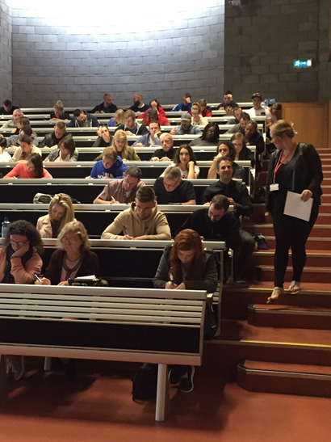
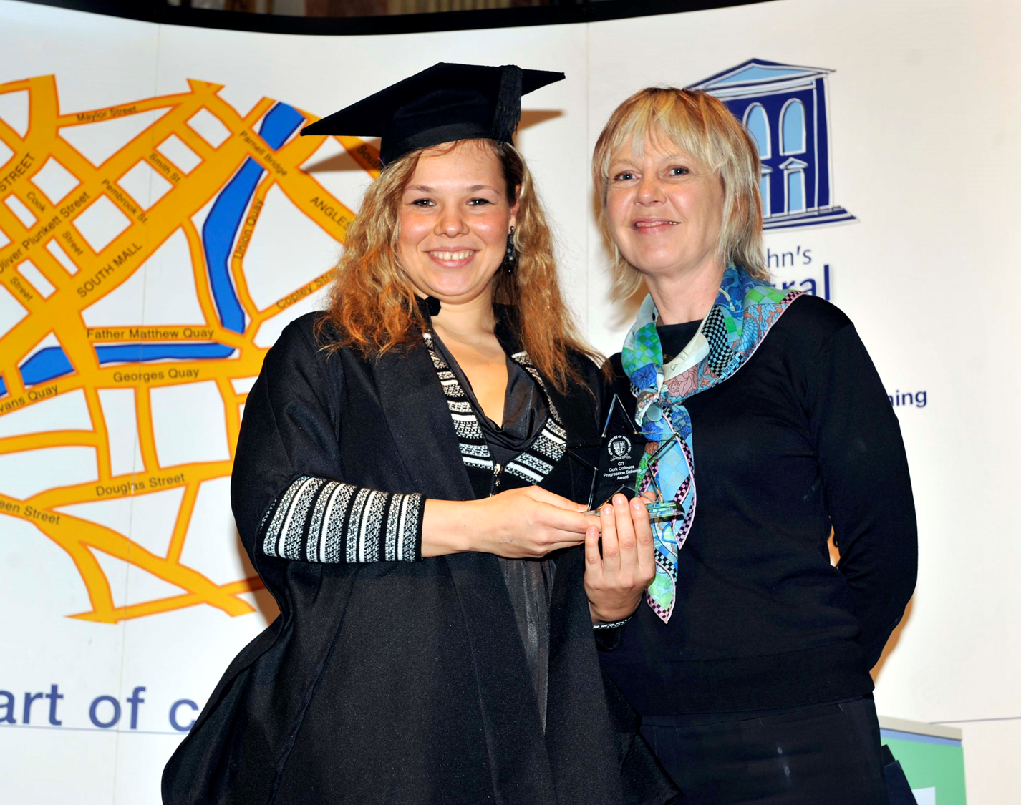
Other Elements
FE/CIT Working Group
Information Sessions in the Colleges
QQI Maths Programme for students who have applied for Business and Humanities Programmes
Department meetings – computing, horticulture, media communications, etc. Input from students
Further Education Awards

Slide 21
Data 2018-19
Source: Lenka Forrest, CIT Admissions

Slide 22
Data 2018-19

Slide 23
Data 2018-19

Slide 24
Data 2018-19

Slide 25
Data 2018-19

Slide 26
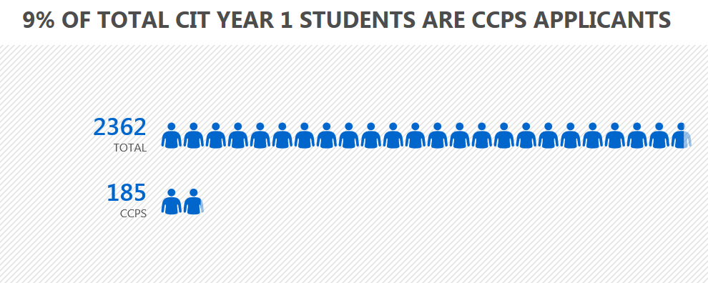
Let’s Look at our Stats 2,362 cao acceptances Y1

Slide 27
Feedback from CIT Colleagues
Great opportunity to offer places with local Educational FE Stakeholders
The biggest issue for me in this regard is the multiplicity of access routes for applicants whereby there may be several students applying through each of the various routes (eg. Direct Entry, CCPS, Mature Entry, etc) and it is an arduous task trying to keep a record of individuals across each of the different pathways on offer.
All advanced direct entry students require a number of inductions.

Slide 28
Sometimes the transition to Year 2 of 3rd level is difficult, as they are dealing with the shock of larger groups again, lectures with 80 students (seminars are on average 20 students, workshops 15 students) - students need to transition to utilising online resources such as Blackboard et . . On the other hand some students from CCPS progress with no problem.

Slide 29
Feedback from FE
The Further Education Perspective
Helen Ryan
Principal, Cork College of Commerce

Slide 30
Thank You!

