Slide 1
Sustainable Energy Communities Programme
Dr. John Bartlett
Mel Gavin
Dr. Orla Nic Suibhne
THEA Colloquium
18th Nov 2020

Slide 2
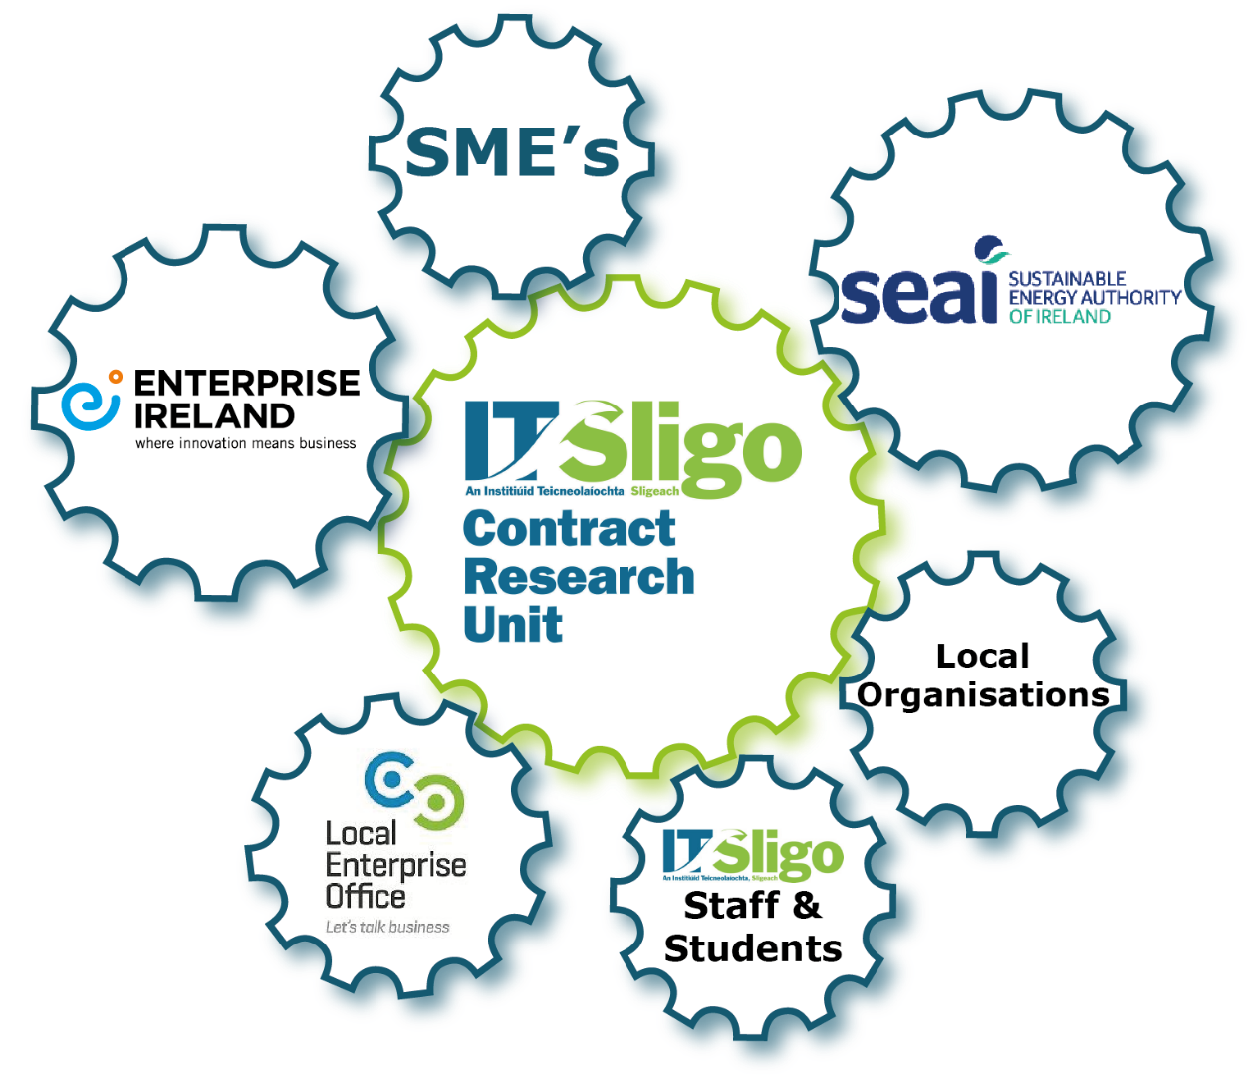
IT Sligo Contract Research Unit
Role of the CRU
The IT Sligo Contract Research Unit (CRU) as part of the Research Office provides dedicated Research, Innovation & Engagement support to regional enterprises, communities, individuals and the public sector.
CONNECT
ASSESS
SUPPORT
ENCOURAGE
Notes:
CRU evolved from an EU project (CREST) to become a permanent service of IT Sligo.

Slide 3
IT Sligo Contract Research Unit
Quadruple Helix/ Open Innovation
(Source: Curley, M. 2013)
Notes:
CRU evolved from an EU project (CREST) to become a permanent service of IT Sligo.

Slide 4
IT Sligo Contract Research Unit
Impacts to date of the CRU
A database of 1000+ companies developed
> 100 companies worked with to date
Innovation Voucher activity increased from 8 to >30
4 EU projects won
A system of regional clinics designed to reach out to companies
12 companies moved on from small-scale problem solving to larger schemes, such as Innovation Partnerships, or EU projects
Connected to a nationwide community network

Slide 5
Sustainable Energy Communities (SEC) Programme
Supporting communities to become part of the energy transition
2015 Energy White Paper Ireland’s Transition to a Low Carbon Energy Future 2015-2030
SEAI developed the programme from a pilot in Dundalk
Provides capacity building support
Enables local teams to lead energy projects & initiatives
Clear energy strategy as guidance
Use less
Use clean
Use smart
Notes:
SEC Programme – Concept
Emulates the Tidy Towns team model

Slide 6
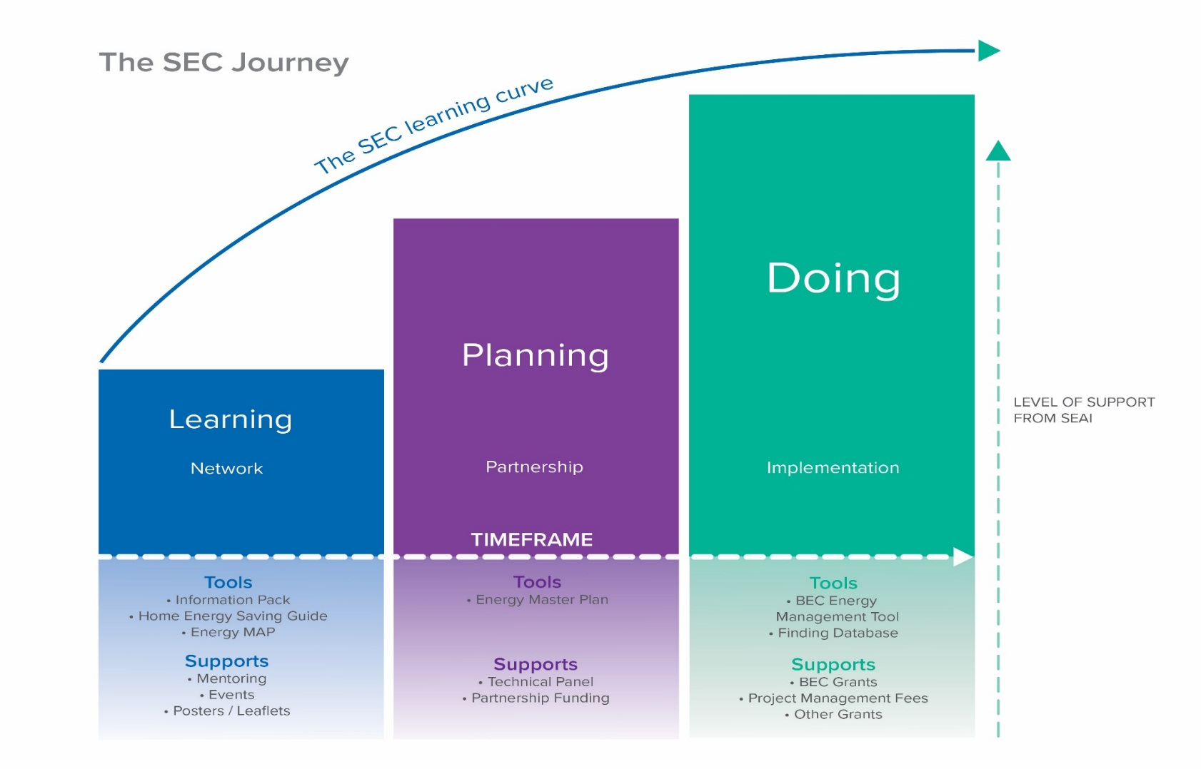
Sustainable Energy Communities (SEC) Programme
SEC Journey
Structured approach to project development
Supports provided
Dedicated Mentor(s)
Energy Master Plan funding
Better access to capital grants
Notes:
SEC Jounrney: Learn-Plan-Do
SEC support

Slide 7
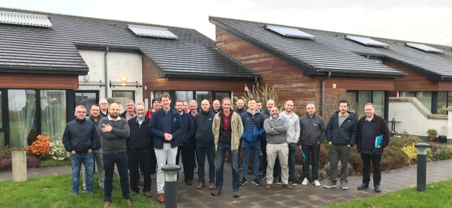
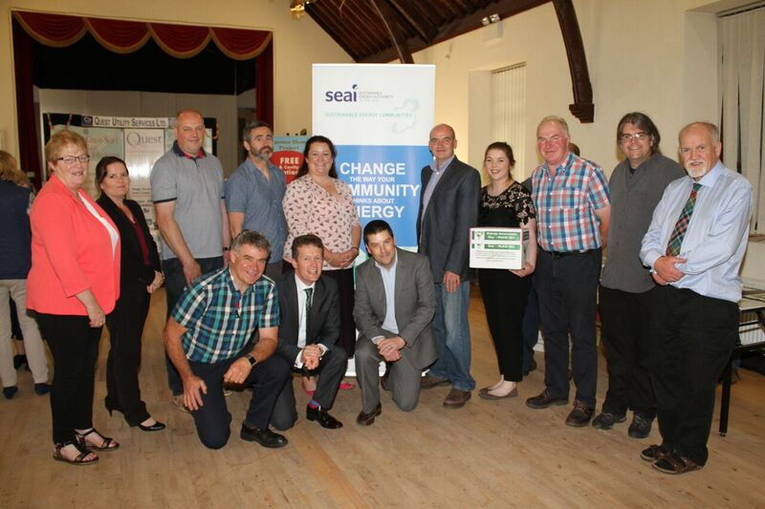
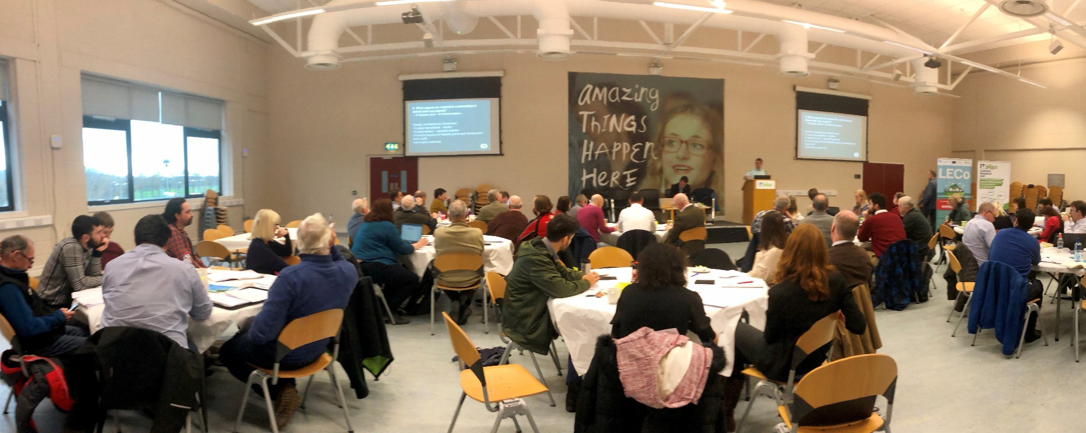
Sustainable Energy Communities (SEC) Programme
IT Sligo – Motivation
Working with existing partners in the field – Plan Energy
Pathway to continuous community support
Leads to further engagements with all sectors
Stimulate clean energy market
Notes:
Reducing the risk (perceived) of energy investments

Slide 8
Sustainable Energy Communities (SEC) Programme
Evolution of the Programme 2016 - 2020
Sep 2016
Border Region
Jan 2017
Border: 14 SECs
May 2017
Border: 19 SECs
Sep-Nov 2019
Border: 38 SECs
5 SECs in place
Dublin Region: 12 SECs in place
Dublin: 37 SECs
March 2020
Border & West Region
9 Counties (10 LAs)
Team of 4 Mentors
Nov 2020
Team of 15 Mentors
126 SECs
86 SECs
Notes:
Reducing the risk (perceived) of energy investments
Contribute to emerging policy

Slide 9
Sustainable Energy Communities (SEC) Programme
Map
Notes:
Reducing the risk (perceived) of energy investments
Contribute to emerging policy

Slide 10
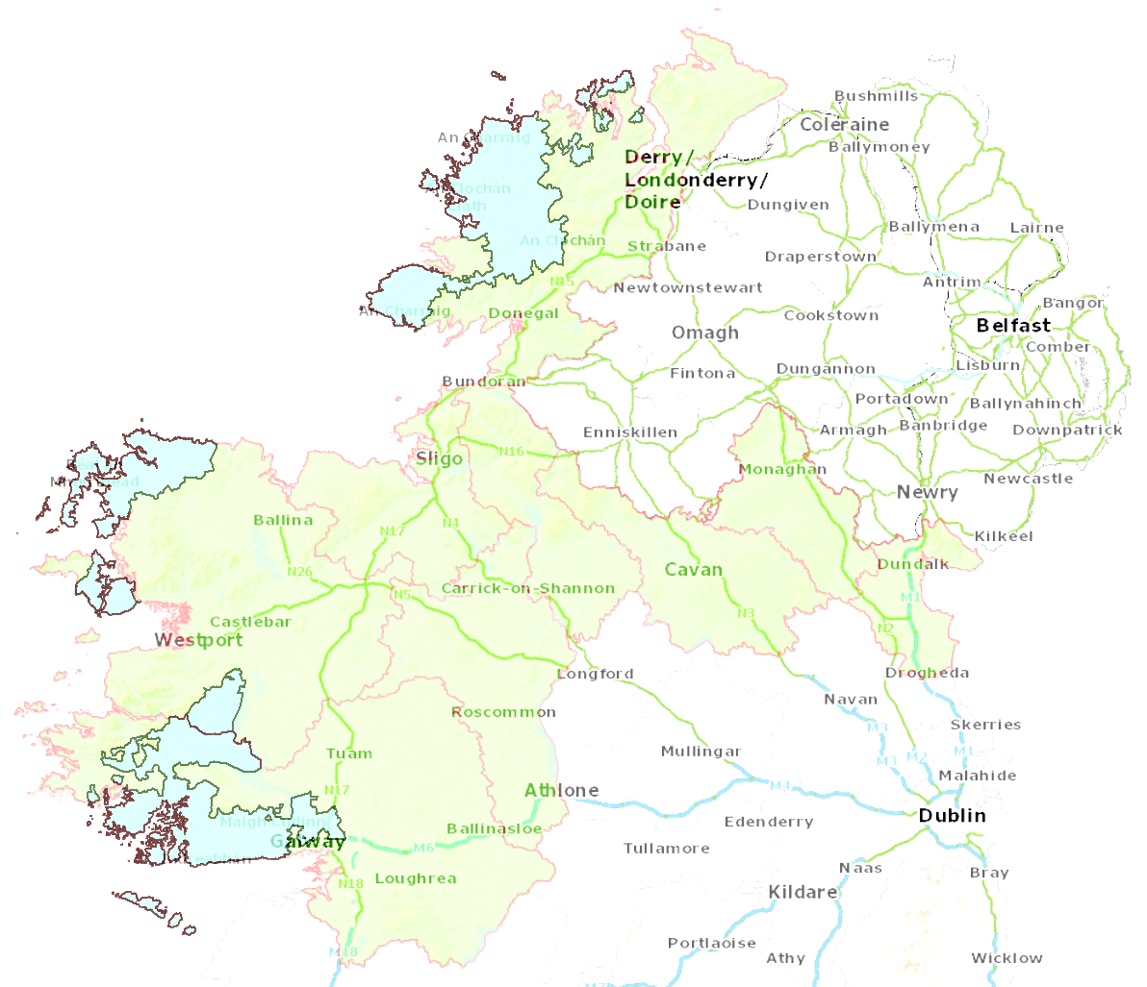
Sustainable Energy Communities (SEC) Programme
Regional Coordinators
Mel Gavin
Stevie Donnelly
County Mentors | Cavan | Donegal | Galway | Galway City | Leitrim | Louth | Mayo | Monaghan | Roscommon | Sligo
 | Ray McNally | Stevie Donnelly | Orla Nic Suibhne | Gavin Forkan | Paul McNama | Eugene Conlon | Orla Nic Suibhne | Nicola Murphy | Barry Lowe | Gavin Forkan
 | Mary McCabe | Eithne Uí Ghallachóir | Mel Gavin | Mel Gavin | Clodagh McManus | Gerry Reaburn | John Scahill | Gavin Forkan | Mel Gavin | Stevie Donnelly
Notes:
Peripheral region – infrastructural deficits
Mature SECs becoming Mentors to new SECs

Slide 11
Sustainable Energy Communities (SEC) Programme
SEC Programme Impact
Border & West C. 126 SECs (25% of total on network)
SEC stage | Recruit | Learn | Plan |  |  | Do
SECs on the network | General engagement | General engagement | EMP application in progress | EMP application submitted | EMP in progress | EMP complete
114 | 3 | 35 | 26 | 27 | 11 | 12

Slide 12
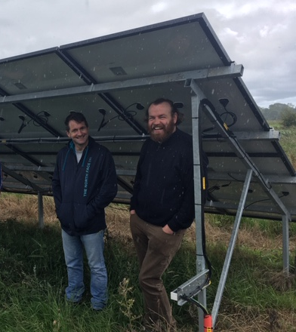
Sustainable Energy Communities (SEC) Programme
SEC Programme Impact
Understanding energy use in the community
Energy Master Plans – clearer route to energy transition
Communities participating directly in energy projects
Making sure our region is not left behind
Supporting significant real-life energy & CO2 savings
Notes:
Polecat GWS – Solar PV providing 60% of the total pumping energy

Slide 13
Sustainable Energy Communities (SEC) Programme
SEC Programme Impact – Experience from the ERRIS SEC
Local team: 14 people
Community projects started in 2014
Collaboration opportunities
Mayo County Council
Údarás na Gaeltachta
Retrofit Energy Ireland Limited
Chamber of Commerce
SEC Network
Ready to do Energy Master Plan

Slide 14
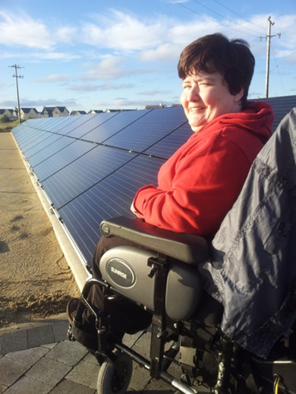
Sustainable Energy Communities (SEC) Programme
SEC Programme Impact – Experience from the ERRIS SEC
€1.2m invested since 2014
€100k per year in energy savings
14 community groups benefitted: Irish Wheelchair Association, Western Care, Electric vans for local Meals on Wheels
Community halls retrofitted
Heating system upgrades
4 x PV arrays installed
LED lighting
6 x National Schools retrofitted
1st community owned Electric Bike in Ireland

Slide 15
Thank you
THEA Colloquium
18th Nov 2020

