Slide 1
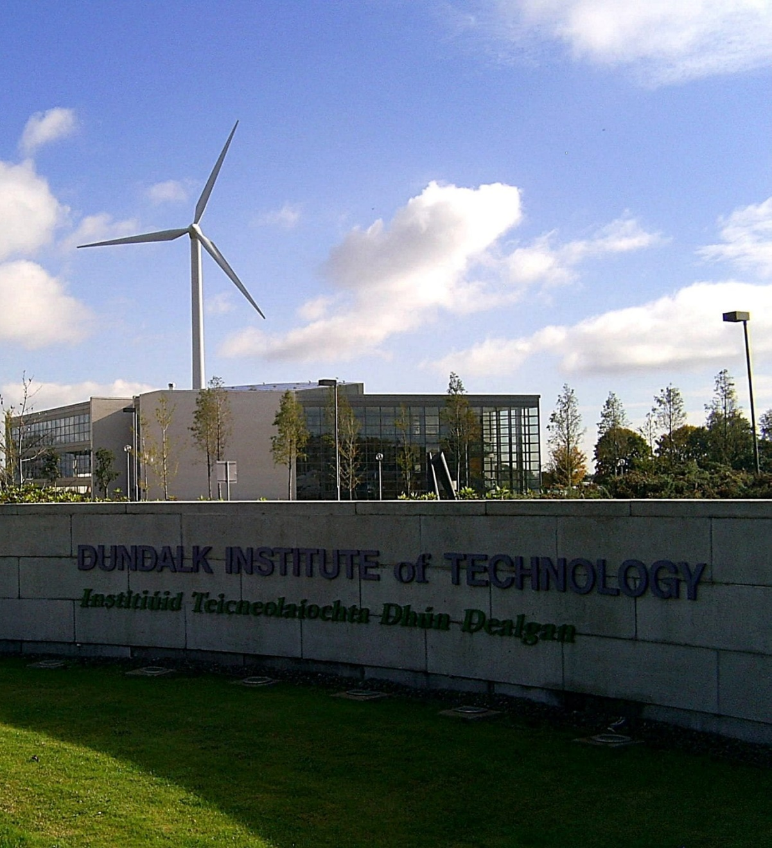
DkIT Connect
Connected Health & Wellbeing Innovation & Learning Hub
Aidan Browne
Head of Innovation & Business Development
Thomas McEvoy
Head of Louth Local Enterprise Office, Louth County Council

Slide 2

Growing Opportunity
Market

Slide 3



DkIT Research & Innovation

Slide 4

Regional Development Centre
International Bench Mark 76.5%

Slide 5

DkIT Connect
To transform the business and economic landscape of the North East creating an internationally recognised research, innovation & learning hub in the Connected Health & Wellbeing space, engaging industry and researchers collaboratively and stimulating “born global” high growth potential businesses that create high value jobs
Notes:
Vision

Slide 6


Laying the foundations
Engagement & Validation

Slide 7
Thomas McEvoy
Head of Enterprise
Louth Co. Co.

Slide 9
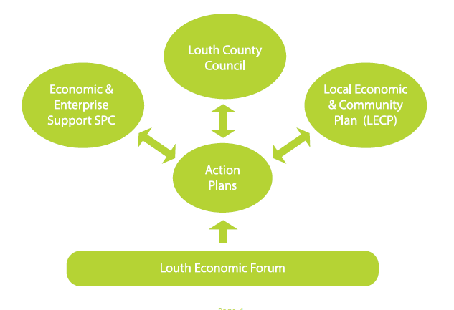

Economic Collaboration
– the Co. Louth Model
Local Government Reform 2014
Louth Economic Forum
Independent Chair alongside representatives from Louth Business and State Development Agencies
Informs Policy and feeds into statutory structures SPC and LECP
Collaborative approach

Slide 10

The Established Task Groups Are:
1. Foreign Direct Investment
2. Sustainable Energy
3. Indigenous Industry
4. Tourism & Heritage
5. Age Friendly
6. Education & Training
7. Agriculture, Food & Fisheries
8. Broadband
9. Making Louth The Best County To Do Business
10. Drogheda, Dundalk, Newry Corridor

Slide 11
Other examples of LCC’s Economic Collaborations
Regional Enterprise Plan
- Steering Committee and funding Programme Manager
Regional Skills Forum and NE LEAN Network
Statutory Structures: LECP, LCDC, SPC (Economic Development)
LAG (LEADER Programme)
Board of Directors: MicroFinance Ireland, BIDS (Dundalk & Drogheda),
Louth County Enterprise Fund, Boyne Valley Flavours,
Community Enterprise Companies / Board:
- The Mill, Creative Spark, Ardee Business Park, Oriel Hub
Representation with InterTrade Ireland
Joint Louth-Meath Food Strategy (Boyne Valley Flavours)
European Programmes (Peace/ Co-Innovate/SHIP/REAL/Age Friendly)

Slide 12
Focus of LCC’s Economic Development
is on Drivers of Investment Decisions
Talent – critical mass of population/ profile of population
Track Record – peer companies encourage others to invest/ cluster effect
Technology – teleco/infrastructure/specialist skills
Connectivity – links to international ports and markets
Property Solutions - Availability of modern ‘turnkey’ properties (suitable buildings, locations, legally clean, technical standards) – in an urban/city type setting.
For indigenous companies – access to Accelerator/VC funds/markets
Competitiveness & Costs (Labour/ Property)
Education/ Skills / Access to Research and 3rd level
Attractive location offering quality lifestyle to employees/families eg. restaurants, schools, public realm, footfall, etc..
(Not considering Rep. Ireland factors: EU; Euro; Tax)

Slide 13
Talent
Young and highly educated workforce, in Ireland’s most densely populated region outside Dublin.
A growing population of 2.25 million in 10% of the land mass. Projected 2.61m. by 2031
Unrivalled – greater than Cork + Derry + Limerick + Galway + Waterford combined!
Within a 60 minute drive
majority (72%) in urban centres >10k population
(vs. Island 50%)
Population density x3.9 the Rep. Ireland average.
Almost ½ Rep. Ireland population.
34% of the all-island population.

Slide 14































Engagement & Validation

Slide 15





Building blocks
High degree of knowledge sharing, skills transfer & mutual learning
High density of actors &
track record
Infrastructure & physical proximity
Higher value creation
Across the ecosystem
Strong network, partners & collaborative culture

Slide 16


Funding
€940K
€3.77M

Slide 17
End
The Whole is Greater than
the Sum of its Parts

