Slide 1
Athlone IT Operations Centre
THEA Nov 2020

Slide 3
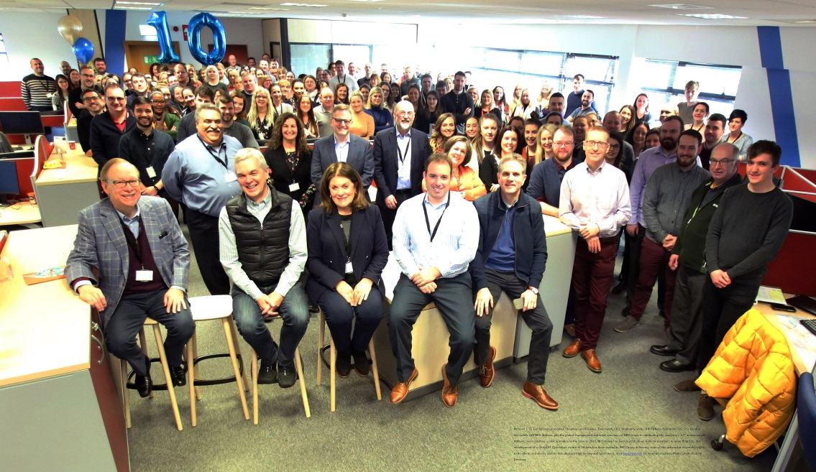
Today - 2020
Growth; Moved to modern facility in 2017, Celebrated 10th anniversary Feb 2020
‘End to End’ production; 75% for Europe. Data Classification, DQM, Process Control, Data Collection.
Global Operations practice footprint; Euro Sports, Global Toys, Global Beauty, CREST/Salestrack, US Footwear.
IT Security Operations, AIT R&D partnership with EI & IDA backing , European Desktop Support, Global Helpdesk, Network Engineering, Retailer Engagement, 6 Sigma.
150 + Employees, 15 nationalities. An enthusiastic and experienced team.

Slide 4
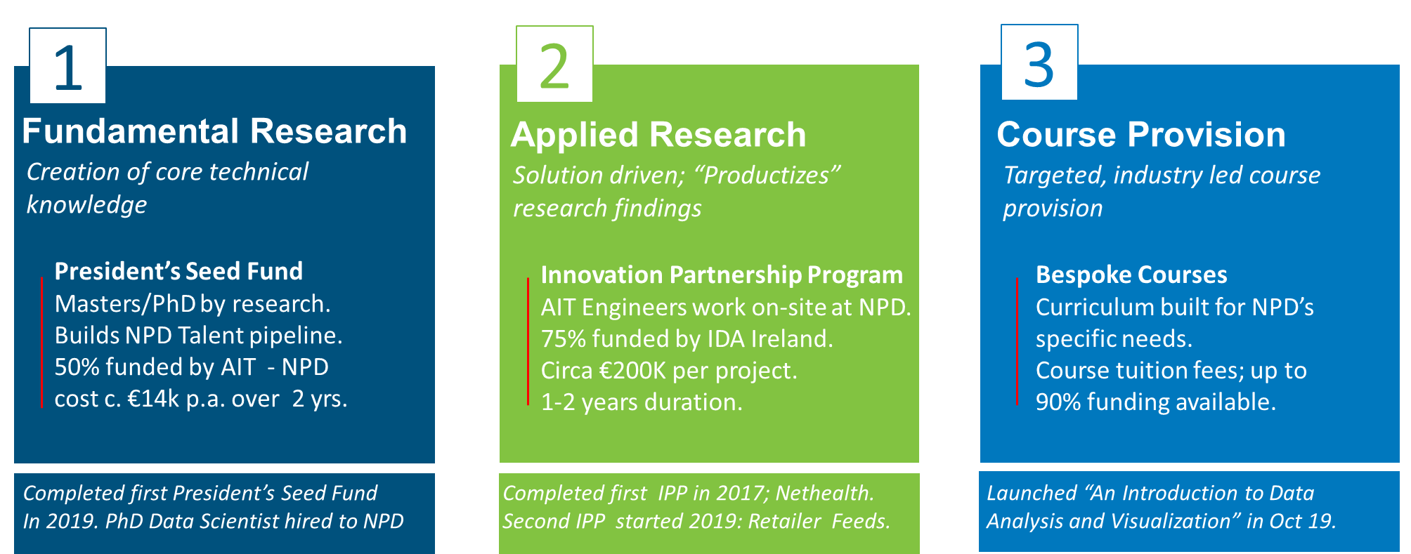
Collaboration mechanisms with AIT/IDA/EI
Generous funding available from AIT and the Irish government thru IDA / EI.
A strong relationship has been built up with AIT via the COMAND Technology Gateway .

Slide 5
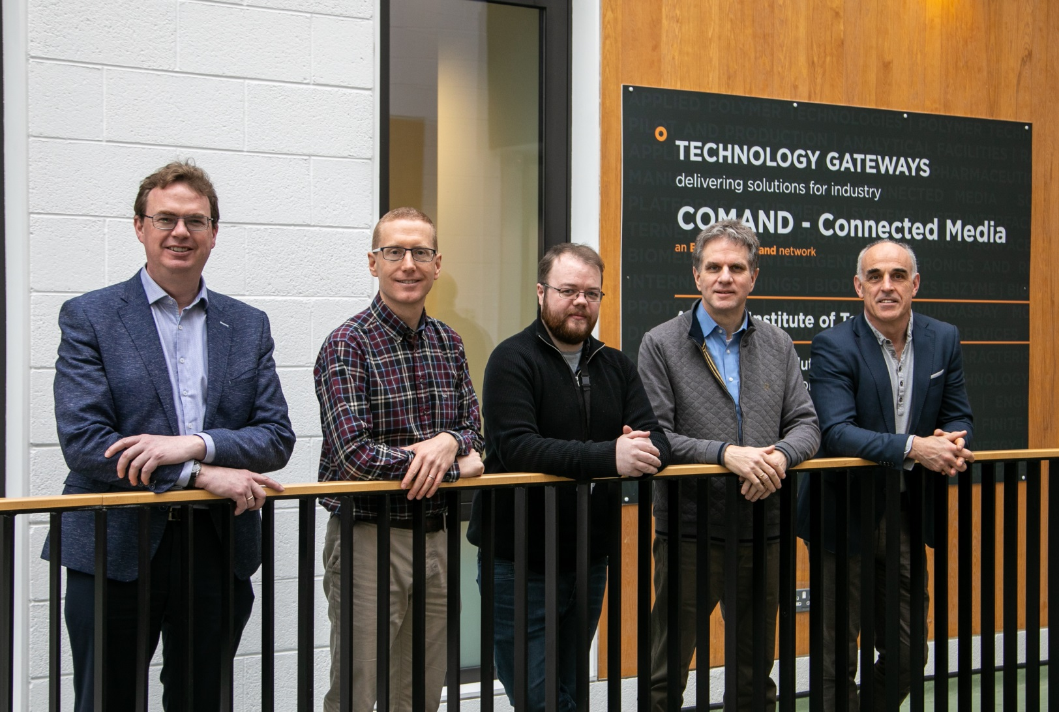
The R&D Team – ‘POC Generators’
Darren Person
Executive sponsor & Project sponsor
Dermot Ainsworth
Project Leadership
Paul Connolly
Technical leadership
Dr Kieran Flanagan
Data ML & AI expert
Dr Enda Fallon
AIT Head of Dept. of Electronic & Software Eng.
Anthony Cunningham
AIT COMAND @ Software Research Institute

Slide 6
NPD/AIT/IDA/EI collaboration to date
“Nethealth” & “Pandora” machine learning anomaly detection & visualization
Nethealth #1
Risk Visualization
of the NPD Network - in Production.
2017-2019
Production ready ML Code.
Network Anomaly Visualization.
2020
IPP #3***
June 2020
Applied Research
with AIT; IPP#1*
Fundamental Research with AIT; President’s seed fund
Applied research with AIT; Retailer data
anomaly detection; IPP #2**
2015-2017
Nethealth #2
Machine Learning (ML) of Risk;
network anomaly detection - in Production.
2019
“Pandora” for Retailer Data
Deploy proprietary analytical algorithms, developed for network traffic anomaly detection, to retailer feeds.
* IPP #1 IP-2014-0499
** IPP #2 IP-2019-0770
*** IPP #3 IP-2020-0934– ML layer on Pandora contextualization and enrichment of data

Slide 7
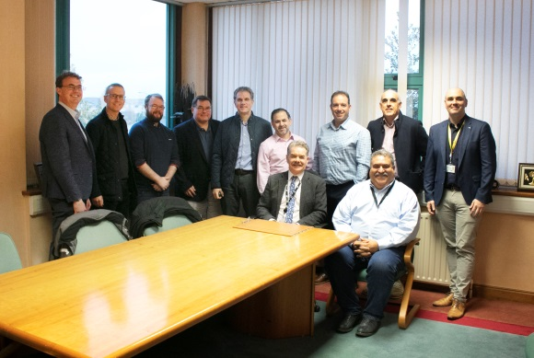
R&D growth; Scaling the AIT - NPD partnership 2021
Replicate ‘N times’ Nethealth & the Pandora POS retailer POC - establish a ‘Data Science Hub’ Athlone based hub for NPD
R&D Collaboration Mechanisms with AIT
Relationships & Resources
NPD Athlone
Data Science Hub
Leveraging both applied and fundamental research to solve specific NPD business ‘problems’
Nov 13 2019; President of AIT Prof Ciarán Ó Catháin with the Dean of Engineering and Informatics Faculty and NPD management team members

