Slide 1




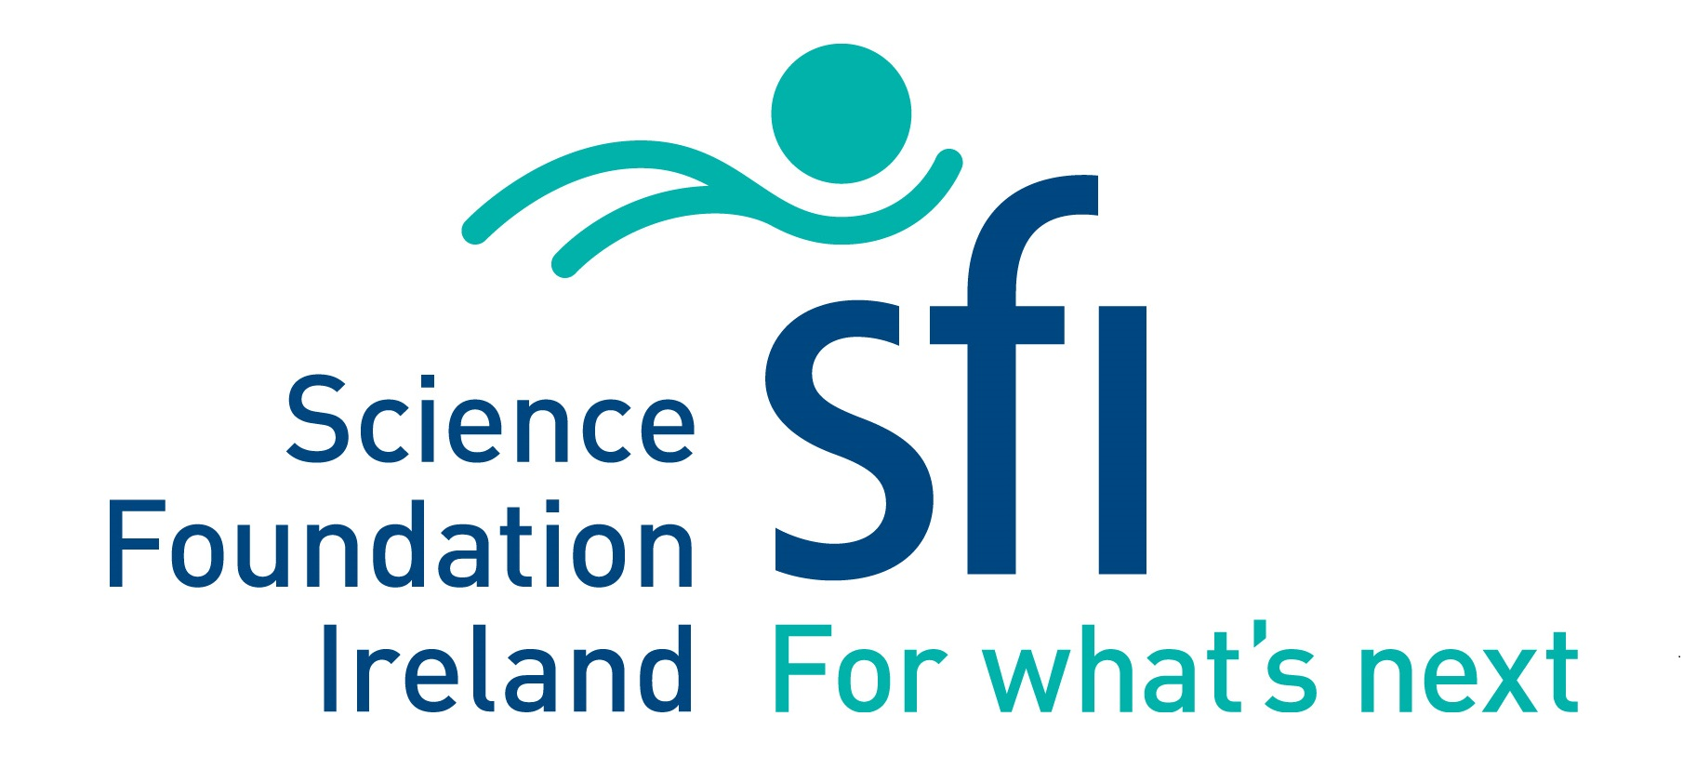
Making Aerosol Safety Known
Dr. Niall Smith
Head of Research / Head of Blackrock Castle Observatory

Slide 2
Stopping Covid-19: Collaboration

Slide 3
CIT
Covid-19 Research Solutions Group
Multidisciplinary
Astrophysicists, Biologists, Business experts, Design Engineers, Photonic scientists, Social Scientists, Virologists
Ethos - Brainstorm
Disruptive Approach
Solutions Driven
Funding stream: SFI Covid-19 Rapid Response Call

Slide 4
(Open) Access to Information

Slide 5
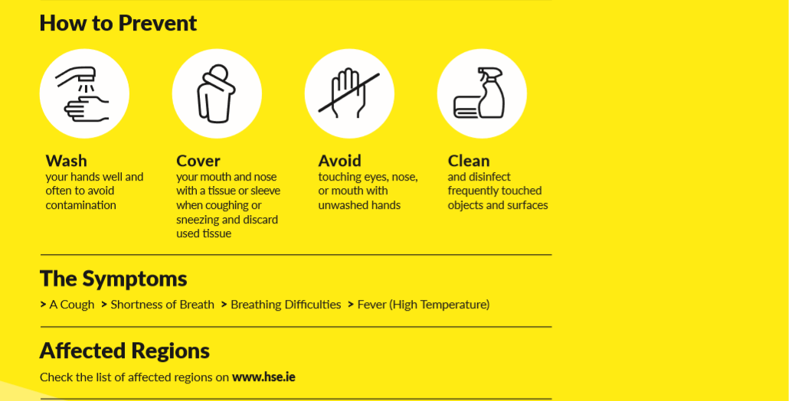
SINGING
TALKING
VENTILATION
March 2020

Slide 6
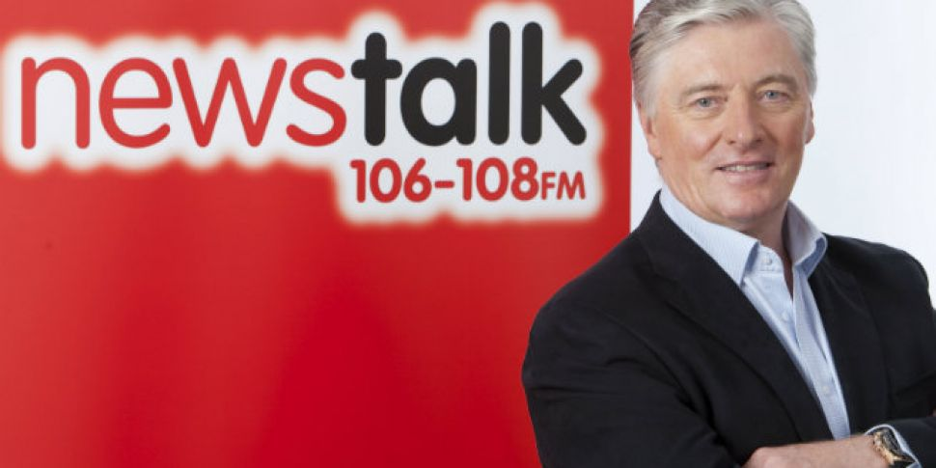
March 2020

Slide 7
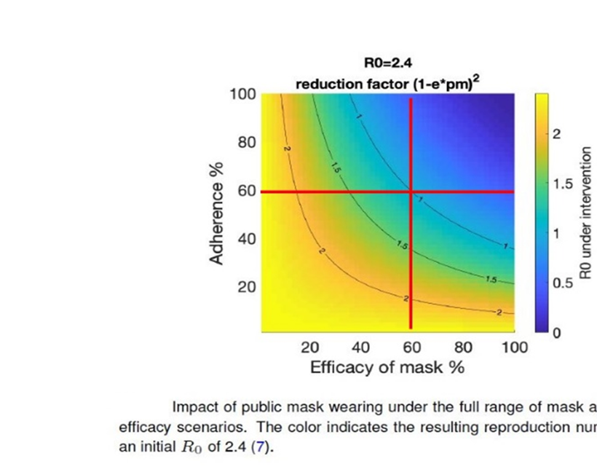
What’s the fuss about MASKS?
Readily available materials
March 2020

Slide 8
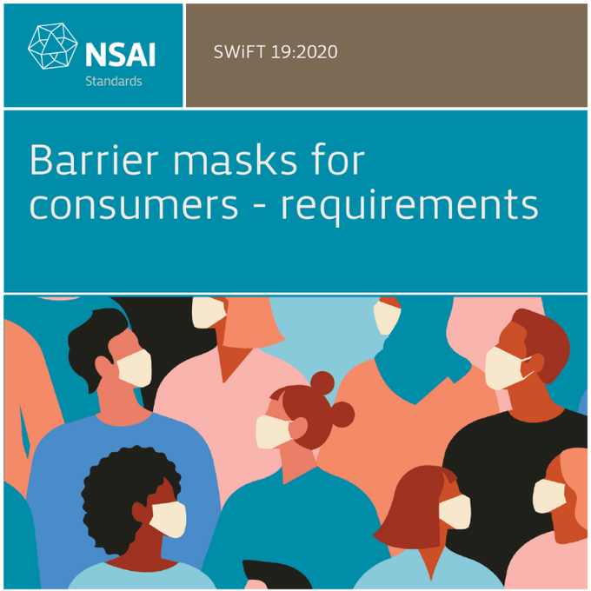
April 2020

Slide 9
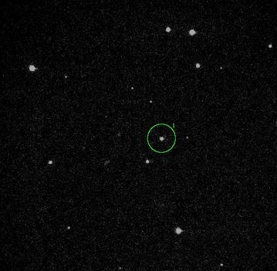
Coughing without a mask
A typical star field
Anfinrud, Philip, Valentyn Stadnytskyi, Christina E. Bax, and Adriaan Bax. “Visualizing Speech-Generated Oral Fluid Droplets with Laser Light Scattering.” New England Journal of Medicine 0, no. 0 (April 15, 2020): null. https://doi.org/10.1056/NEJMc2007800.
Blackrock Castle Observatory. Image taken with 2.2m telescope at Calar Alto, Spain, 2003.
1st May 2020

Slide 10
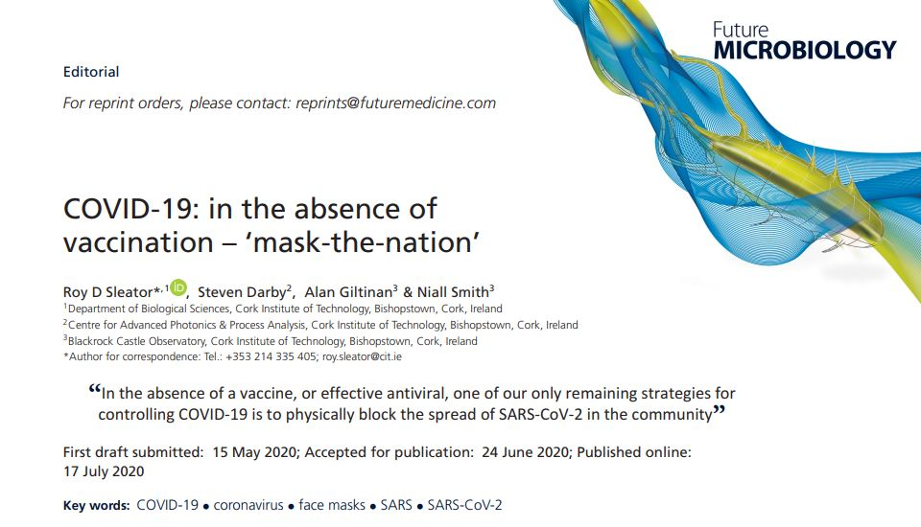

Slide 11
Dissemination and Impact

Slide 12
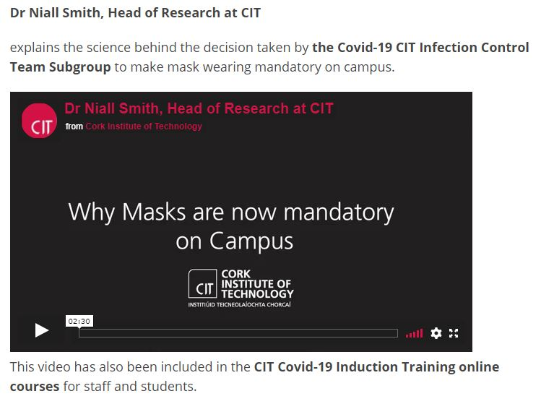
August 2020

Slide 13
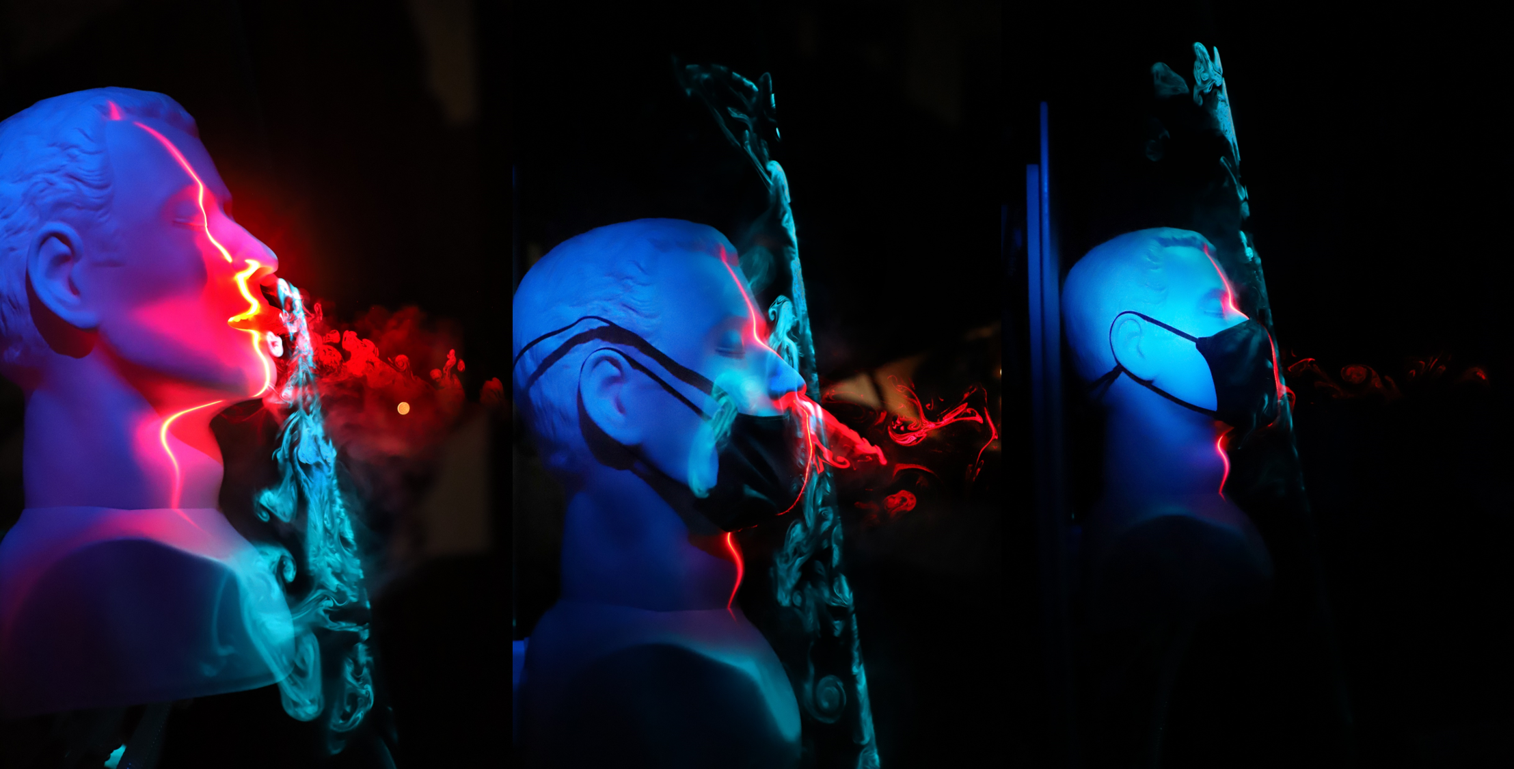
October 2020

Slide 14
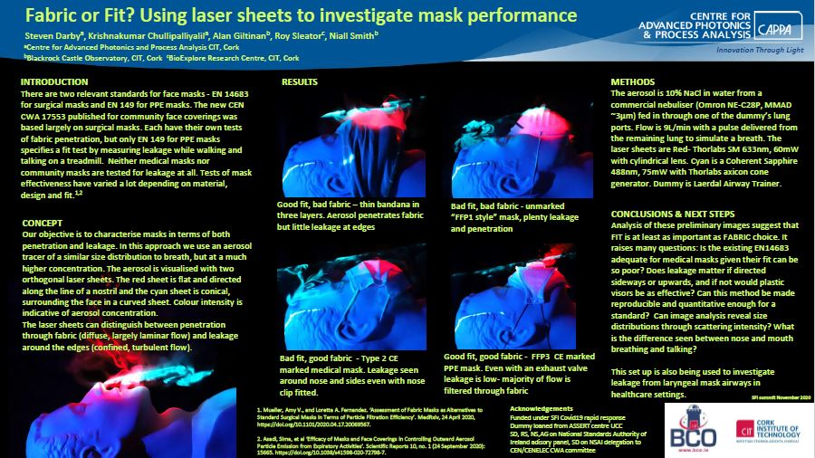
COVID-19: Assessing mask efficacy – fabric & fit (in prep.)
November 2020

Slide 15

Talking Heads

Slide 16
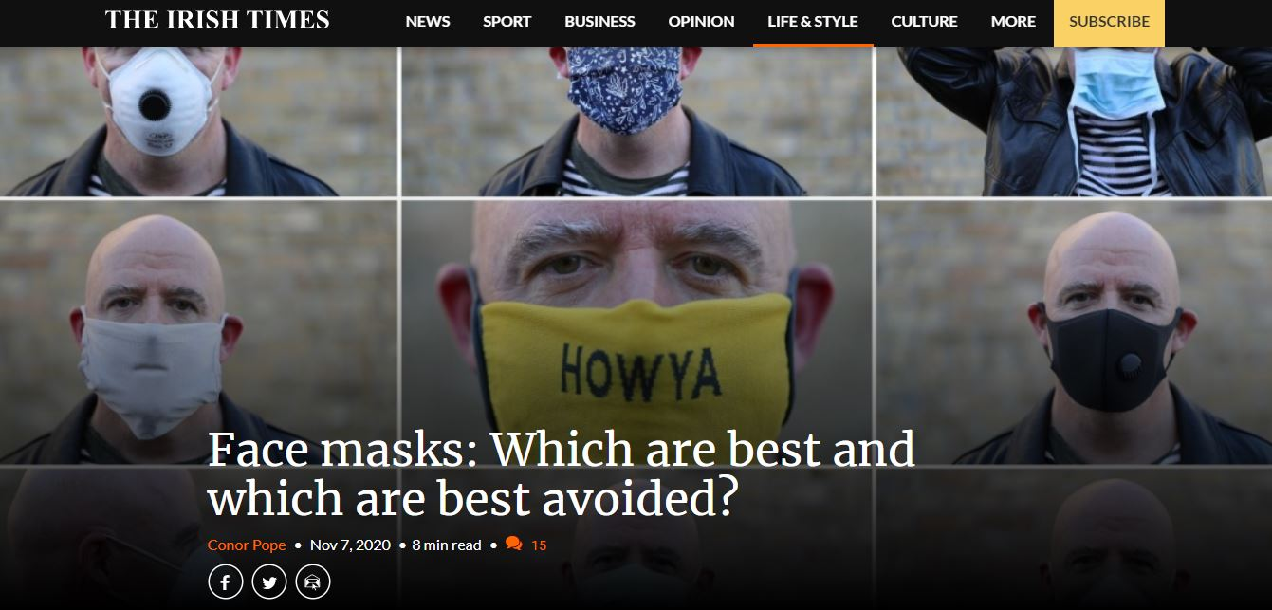
But some news last week was anything but reassuring. Many face masks, it turns out, aren’t that effective. The National Standards Authority of Ireland has warned that the majority of face masks on sale do not protect against the virus.

Slide 17

Collaboration is key
Knowledge continues to evolve
Good Science Communication is crucial
“Fit and fabric” are critical parameters
WEAR A MASK!
CONCLUSIONS

