Slide 2


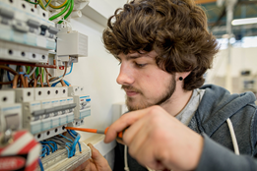

Undergraduate Technological
Higher Education:
A Further Education and Training Perspective
THEA Colloquium
8th May 2019
Notes:
Great to see so many of you here – it really is indicative of what this process has all been about – a diverse group of stakeholders within ETBs coming together to assess strengths & areas of development
Thanks – Ciaran Conlon and his team - Joan, Mary, Therese, Vanessa - probably most involved on a day-to-day basis – but the entire Planning & Investment team critical in ensuring the process worked alongside the other responsibilities as part of annual planning cycle
Thanks to SLT & SOLAS Board – key input & insight – organisation to organisation agreements
Thanks to everyone at the ETBs – everyone bought into the process, most critically the CEs and FET Directors – I know the timing wasn’t ideal , & I know that it was the first time we did it, so there were things that we didn’t get right , but I think everything handed constructively & respectfully in spirit of partnership
On that, must play credit to the role of independent expert panel – some here today

Slide 3
The integrated further education and training system was established in 2013 heralding significant change and development…
2013
ETBs and SOLAS created to bring further education and training systems together for 1st time
Organisation
Strategy
Culture
2014
First integrated further education and training strategy published
2014 onwards
Planning and funding approach and learner database developed
2014-2015
Transition of training centre ownership from SOLAS to ETBs
2015
Action Plan on Apprenticeships & Traineeships launched
2016
First Directors of FET appointed in ETBs
2017
SOLAS Corporate Plan with FET system targets
2018
PLC Evaluation and Reform Programme Published
2018
Strategic Performance Agreements established between SOLAS and the ETBs
Notes:
Significant amount of funding into FET – one of its strengths its diversity and accessibility
Available in almost every corner of Ireland
Incredibly connected to the regions they serve – individuals, employers, communities
People dip in and dip out of FET at different times and on multiple occasions
Conscious that in setting up agreements not just about targets and templates – really wanted to get a flavour of what each ETB all about, unique characteristics & how its responding to a unique set of challenges – agreements & system report today – see series of case studies highlighting innovation & good practice from across the system

Slide 4
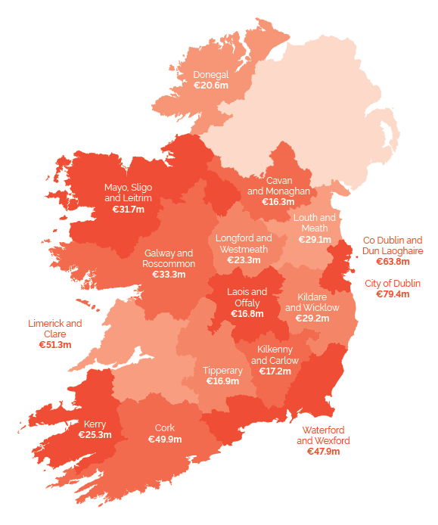
The FET system is fantastically diverse and geographically spread but complex and multi-faceted…
Student cohort roughly equivalent to that of higher education (circa 200k)
However 340k beneficiaries, meaning many accessing more than one course
€640m SOLAS investment (+€140m)
Community based model characterised by small scale provision
Work-based components of much provision
Large proportion of adult learners with competing demands
Level 5 and Level 6 principally delivered via PLC, traineeships & apprenticeships
Step 5
Step 6
Notes:
Significant amount of funding into FET – one of its strengths its diversity and accessibility
Available in almost every corner of Ireland
Incredibly connected to the regions they serve – individuals, employers, communities
People dip in and dip out of FET at different times and on multiple occasions
Conscious that in setting up agreements not just about targets and templates – really wanted to get a flavour of what each ETB all about, unique characteristics & how its responding to a unique set of challenges – agreements & system report today – see series of case studies highlighting innovation & good practice from across the system

Slide 5
FET-HE transitions is critical to the future development of short and first cycle approaches and a data revolution can inform the debate…

Slide 6
FET-HE transitions have become an increasingly important aspect of the education and training system over the last 20 years…
CAO Demand from QQI FET Applicants

Slide 7
Using a FET score is only one route into HE for those with a FET background and there is scope to improve acceptance rates…

Slide 8
We need to move away from treating FET as an ‘access’ route as its relationship with HE is far more significant (and complex!)…
5,132 completing PLC in 2017 moved immediately into HE in 2017/18 plus 272 from other FET courses
18.3%
27.8%
12.1%
of PLC completers
of PLC completers leaving FET
of HE
1st Year Entry
20.1%
483
of IoT/TU
1st Year Entry
of PLC
advanced entry to HE

Slide 9
Some other key characteristics emerging from analysis and discussion of FET-HE transitions include…
Just under 10% of PLC enrolled learners have some HE experience
Indications (but further validation needed) that HE retention rates of those with previous FET experience better than those from low LC points bands entering HE directly
FET-HE transitions are typically in cognate disciplines (63% plus)
90 referenced pathways from FET to UK HE programmes
Inconsistency in FET-HE transition levels by ETB and HEI
Excellent individual relationships in place with clear learning pathways and even co-located HE programmes
Still sense of FET v HE competition and overlap at Level 6
Points based system for technological sector welcome but needs further development
Notes:
Public sector reform, education reform, FET reform.

Slide 10
The FET-HE transitions sub-group has identified areas for further development and consideration…
Strategic Approach
Core
FET
Targets
Strategic approach to objectives and target setting with regular reporting
Consistent Systems
Level 6 Overlap
Standardised entry systems, transition process timelines, feasibility of universal points system
Consistent Systems
Level 6
Overlap
Comparison of outcomes Advanced and Higher Certificate awards at L5/L6 to inform discussion on FET-HE overlap
Areas for
Further Development
Thematic Initiatives
Further Research
Transition initiatives focusing on thematic areas (e.g. health, social care, ICT, childhood education) with targeted funding approach
Thematic Initiatives
Further
Research
Further research & analysis on retention, graduate outcomes, non take-up of places
Raising FET Awareness
Raising FET Awareness
Promote greater awareness of FET provision within HE & simplify structure
Notes:
Public sector reform, education reform, FET reform.

Slide 11
The next further education and training strategy will provide an opportunity to clearly set out an ambition for FET-HE transitions…
1
2
3
4
5
6
Supporting Job Creation
Learning Pathways
Active Inclusion
Lifelong Learning & Workforce Upskilling
Meeting Key Skills Gaps
New Models of Delivery
Notes:
FET been critical to Ireland’s economic and social development for over 100 years but an integrated FET system only in 6th year of existence
New organisations with new responsibilities – natural establishment phase

Slide 12
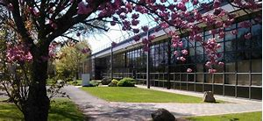
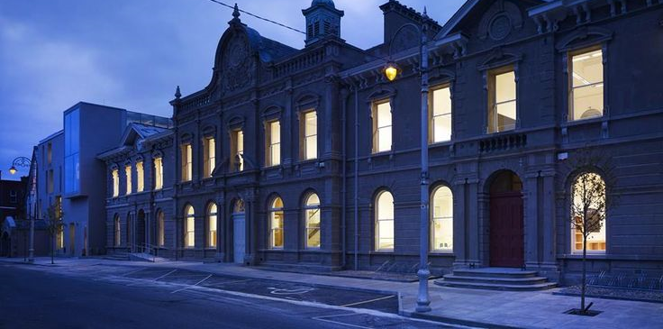
Community access is core attribute of FET but it must move away from a ‘binary’ system at Levels 5/6 to realise its potential…
20 training centres
47 dedicated FE colleges
Move away from training centre vs PLC college branding/divide
Dividing lines between roles of respective facilities becoming more blurred
Small scale of provision leaves some scope for consolidation via capital investment
Integrated FET college/centres hubs for Level 5/6
With a network of more dispersed FET community facilities offering pathways to these hubs
Notes:
Total cumulative additional employment outcomes 7,500 over 3 years

Slide 13
A simplified programme structure where the learner pathway is much more transparent should be possible…
Courses for Employment
Courses for HE Progression
L5/6
Pathway Courses
L3/4
Foundational Courses
L1/2
More consistent FTE driven funding approach for Level 5/6 provision
Uniform approach to L5/L6 programmes in each ETB area (e.g. contact hour divergences addressed)
Courses for employment and HE progression both offered within integrated FET colleges
Notes:
Total cumulative additional employment outcomes 7,500 over 3 years

Slide 14
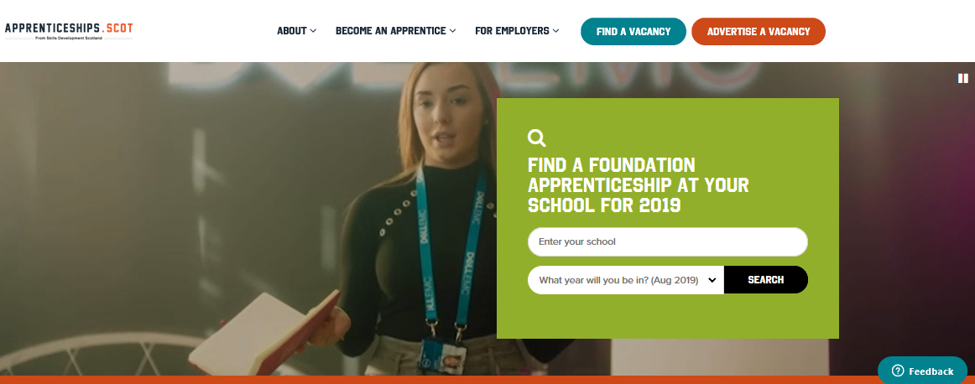
We share a common goal of developing vocational and technological pathways and second level needs to be more effectively targeted…
Changing culture and demand for vocational options is only part of battle – many schools lack capability to offer such choices…
Second
Level
Further Education & Training
…but FET already has this expertise if a flexible delivery model can be found
L5/L6 modules
Notes:
Total cumulative additional employment outcomes 7,500 over 3 years

Slide 15

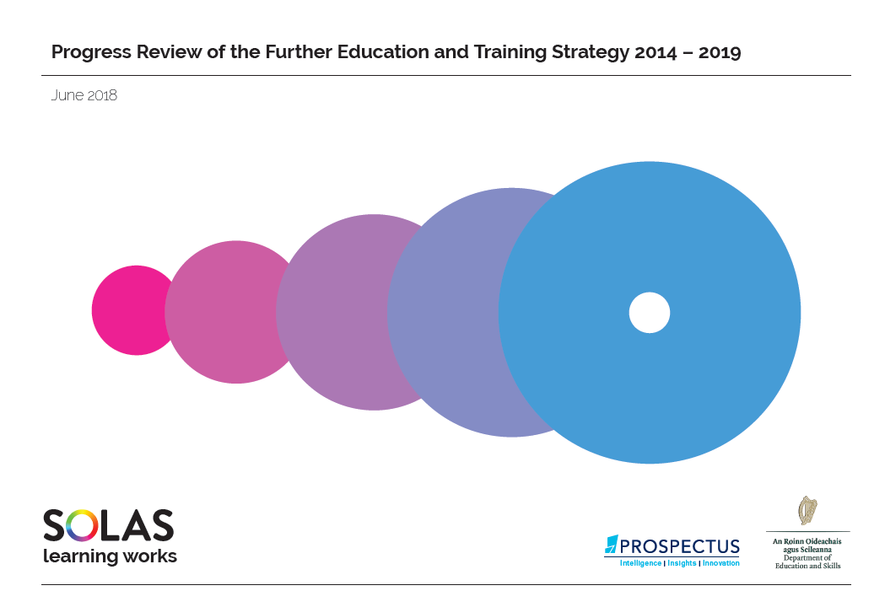

A framework for the future development of the wider tertiary system could help to answer some complex questions…
Skills development
Learner pathways
Demographic planning
Progress Review of first FET strategy recommended holistic vision for future development of education and training
Building on existing synergies there are clear areas where the FET role & contribution should be clear
DES has integrated further and higher education functions committed to an integrated tertiary education framework in 2019
Notes:
Total cumulative additional employment outcomes 7,500 over 3 years

