Slide 2
Agenda
Introduction
Methodology
THEA’s mission
Mission, functions & activities
High level goals
Goals, objectives, & actions
Operating principles
Conclusion & next steps

Slide 4
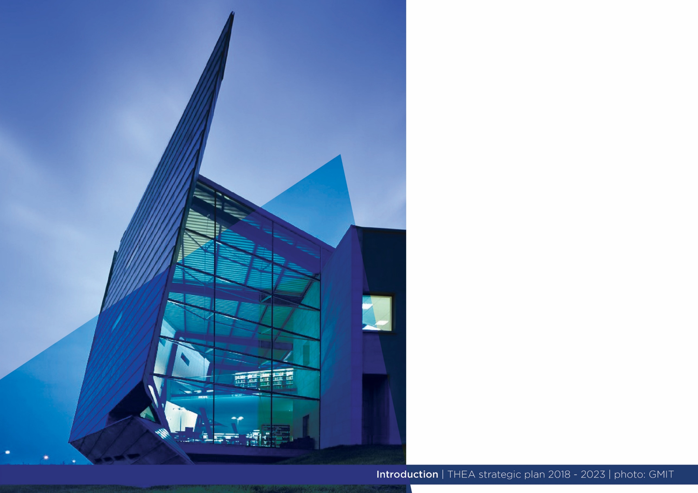
Introduction & Overview
• Launched in April 2017 - representative and advocacy body for the technological higher education sector
• Sector comprises 14 institutes of technology geographically dispersed across the country
• Undergoing radical transformation with advent of technological universities - TU Dublin will be designated in January 2019
• 2018 14 IoTs
• 4 technological universities and 4 autonomous IoTs in 2020-21 (?)
• THEA also changing in line with sector’s transformation: reflected in new Strategic Plan 2018-2023
• Influencing and shaping HE policy agenda is at the heart of new strategy

Slide 6
Methodology
• Extensive audit and
consultation process
• Involved THEA executive, staff members from the sector, stakeholders
• Process overseen by THEA executive with Steering Group
• External facilitator
Notes:
Organisations consulted:
Ibec
Union of Students in Ireland
SOLAS
Teacher’s Union of Ireland
Higher Education Authroirty
Department of Education & Skills
Enterprise Ireland
Education 7 Trainng Boards Ireland
Irish Universities Assoication
Quality & Qualifications Ireland
Science Foundation Ireland
Fórsa
Irish Research Council
Department of Business, Enterprise & Innvoation

Slide 20
THEA will also support this fundamental operating principle with four supporting principles. Thus, THEA will:
• Be collaborative - we collaborate with our stakeholders, both within and without the THEA community, to enhance and promote the value of technological higher education
• Be future-oriented - we look forward in order to reflect the dynamic nature of our members and the innovative possibilities of technological higher education
• Add value - we seek to add value so that our members and other stakeholders derive tangible and distinct benefits from our work
• Seek consensus but act decisively - we seek to build consensus among members on key issues facing the sector but have agreed mechanisms on how to proceed in the absence of consensus.

Slide 22
THEA’s operational functions fall into three core areas:
- Advocacy & representation
- Member networks; and
- Services to the broader THEA community
High level goals will determine the organisation’s workflows over the next five years
THEA executive will work collaboratively with its members to articulate and frame a vision for the technological higher education sector
Achieving consensus across the sector as a whole was vitally important to producing this Strategic Plan and will be the basis of the next step; defining a vision for technological higher education

Slide 23
