Slide 1
Research Infrastructure in the Technological HE Sector
Dr. Jennifer Brennan
Director of Research & Innovation

Slide 2
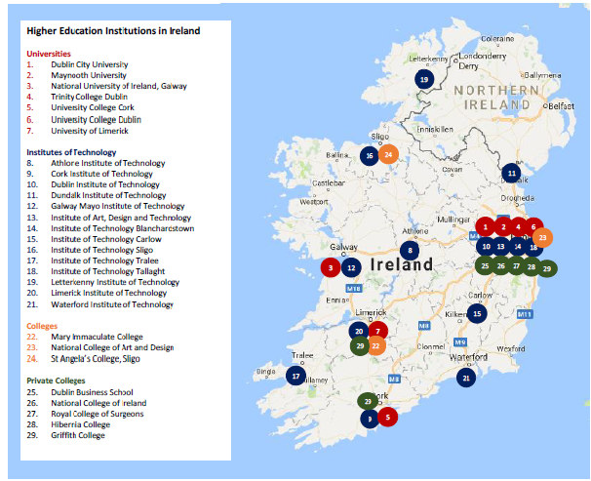
Technological Higher Education
14 Institutes of Technology
Technological University Consortia
DIT, ITT, ITB (during 2018)
WIT and ITC
CIT and ITTra
GMIT, ITS, LYIT
Regional focus
SMEs
Local community
Technology & Innovation Poles (NPF 2040)

Slide 3
Research & Innovation
Postgraduate Student Enrolments | ~1500 14% of HE total
Research Staff | ~400
Annual Expenditure on Research and Development | €60.5M (€5.7M from industry) Increased 3-fold 2004-2014
Knowledge Transfer Metrics | 52% of Business Access to Research Expertise* 20% of Invention Disclosures 19% of Licences, Options and Assignments 21% of New Spin-Outs
Horizon 2020 Income | €16M 9.6% success rate
Company Incubation | 522 companies hosted in incubator
Technology Gateways | 15 Gateways plus 2 Clusters
Large-Scale National Centres | IOTs in 9 of 14 EI/IDA Tech Centres IOTs in 10 of 17 SFI Centres

Slide 4
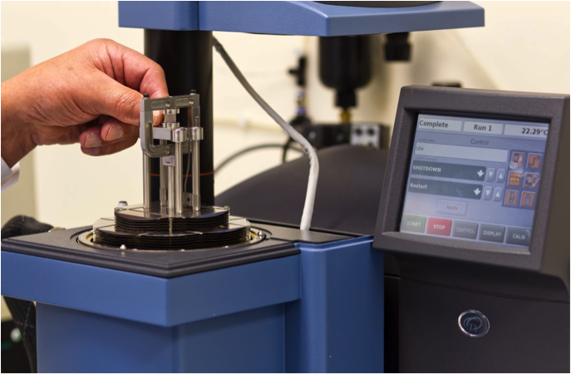
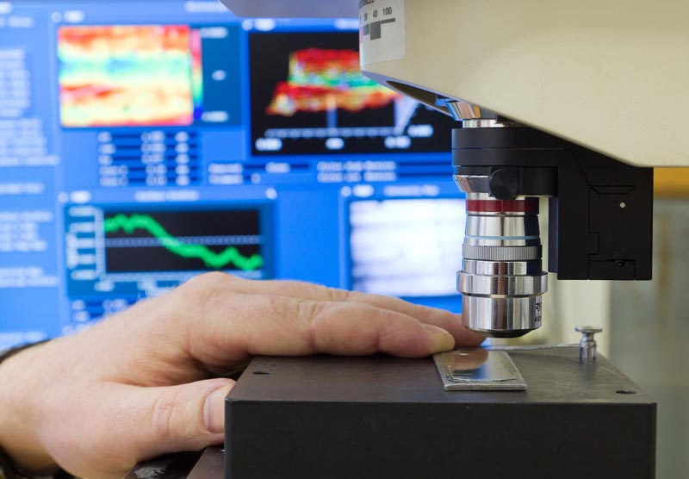
Case Study
South Eastern Applied Materials Research Centre
Cutting-Edge and Industry-Focused Research
Partner in I-FORM Advanced Manufacturing Centre
Part of Technology Gateway Network
Suite of Instrumentation, with capability in:
Materials Characterisation
Mechanical Property Analysis
Failure Analysis
Metrology Analysis
Contamination Identification/Analysis
Design Optimisation
Engineering Simulation

Slide 5
Current Infrastructure Challenges
No dedicated R&I funding in IOT core grant
Challenge to maintain/upgrade existing equipment or source new equipment – relying on donations/loans/external grants
Technology Gateways
Budget = salaries of business development staff, teaching buy-out and travel, not equipment/consumables etc.
Specialised equipment needs specialist staff who can be retained long-term
National Research Infrastructures
LIRE Database not active
Duplication and Access Issues
Many IOT researchers are ineligible for SFI RI Calls
Piecemeal access to electronic resources: e-journals, databases, bibliometric tools

Slide 6
Sample Effect
Knock-on negative effects on delivering on industry-sponsored projects:
Company B required analysis of a sample by High-Performance Liquid Chromatography using a fluorescence detector. The Gateway’s detector is old and was not functioning properly. A repair was not commercially feasible, but the Gateway did not have the funding to purchase a new one. The project did not proceed.
Several companies have approached a Gateway for a service in mechanical characterisation using two pieces of equipment which are over 15 years old, and for which the software has become obsolete. The Gateway cannot currently accept projects which require this technology. They can sub-contract it to a UK company, but this increases cost and lead time.

Slide 7
Future RI Challenges
Challenging to build a research profile without access to appropriate infrastructure
R&I mission is strengthened in Technological Universities Bill => the sector will be more research-active
National Planning Framework 2040 references IOTs as Technology and Innovation Poles supporting regional enterprise
Open Research – data storage, curation and preservation
Impact – bibliometric data

Slide 8
Thank You
jennifer.brennan@thea.ie
@drjenbren

