Slide 1
Covid-19 – A Helping Hand

Slide 2
A Helping Hand
Masks & Visors
Volunteering
PPE Donations
Innovative Technologies
Test Reagents
Advice and Support
Test Centres
Surgical Scrubs
Sanitiser
Notes:
During the first lockdown, the sector’s staff and students turned their talents towards helping with the challenges of the pandemic

Slide 3
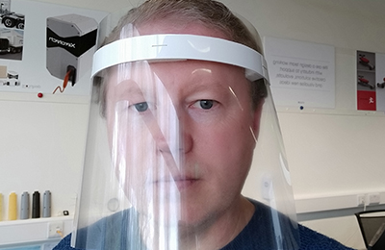
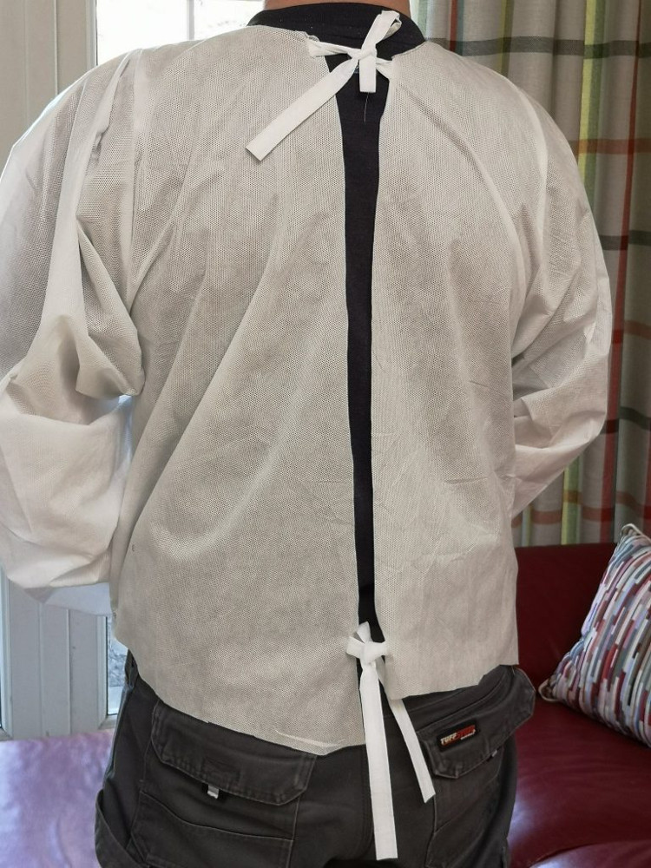
PPE
Bespoke face-shield from IT Carlow
Surgical scrubs designed by LYIT Fashion Students
Bike Marshals deliver LIT-made face shields
Notes:
PPE was the largest area of activity. Multiple examples of face mask/shield production and donations of campus lab PPE to local healthcare facilities.

Slide 4
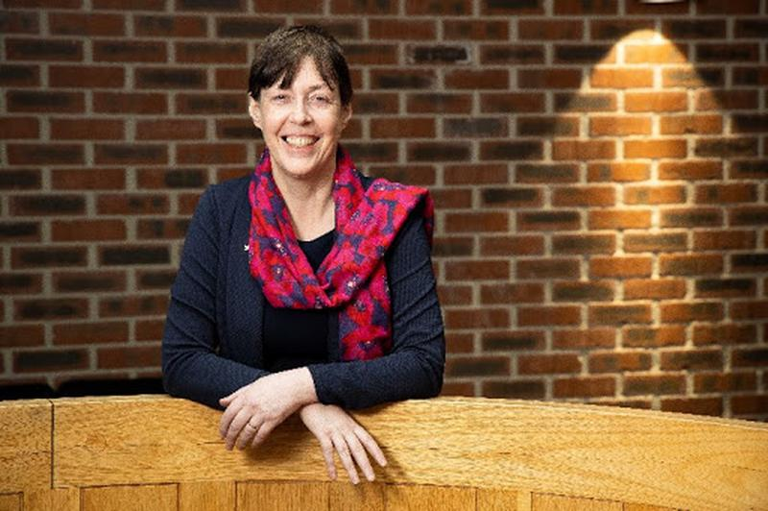
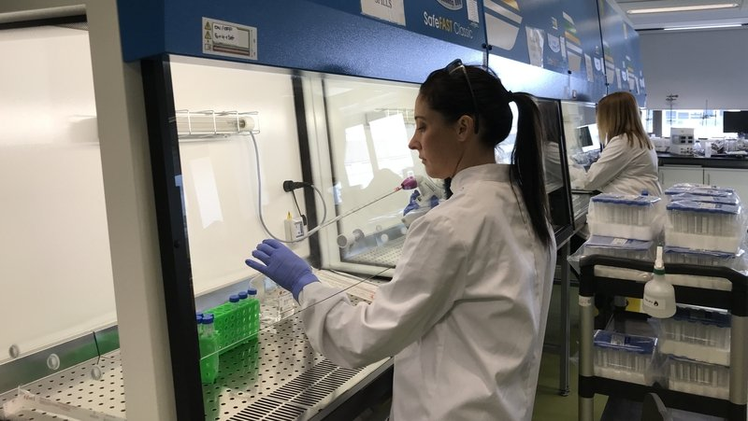
Reagents
Dr Brigid Lucey, CIT, worked with Teagasc, Cork University Hospital, UL and Eli Lilly to produce a lysis buffer for use in Covid-19 testing
IT Sligo scientists led by Dr Jeremy Bird and helped by AIT and GMIT, developed lysis buffer and viral transfer medium for use by Sligo University Hospital

Slide 5
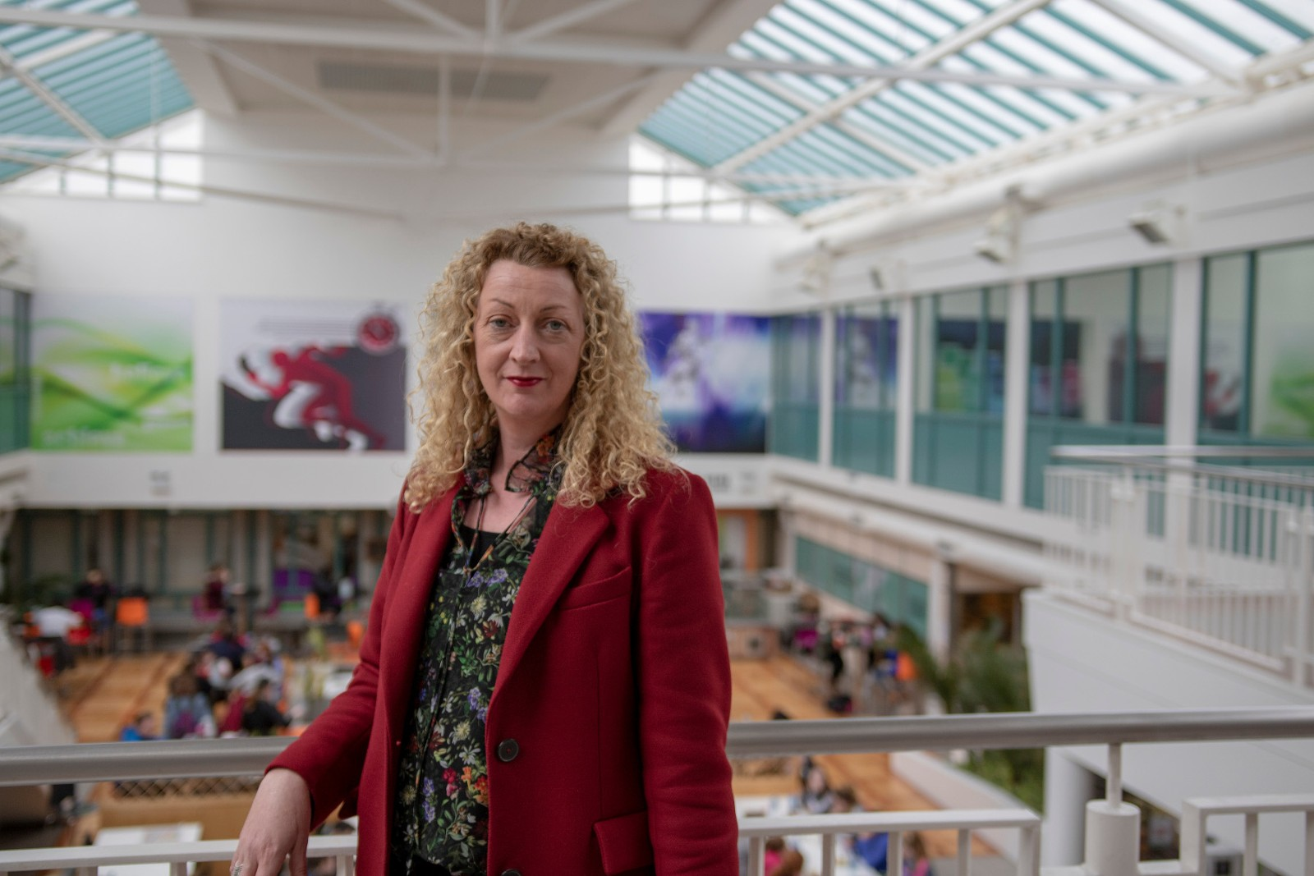
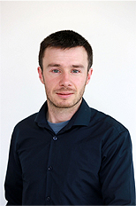
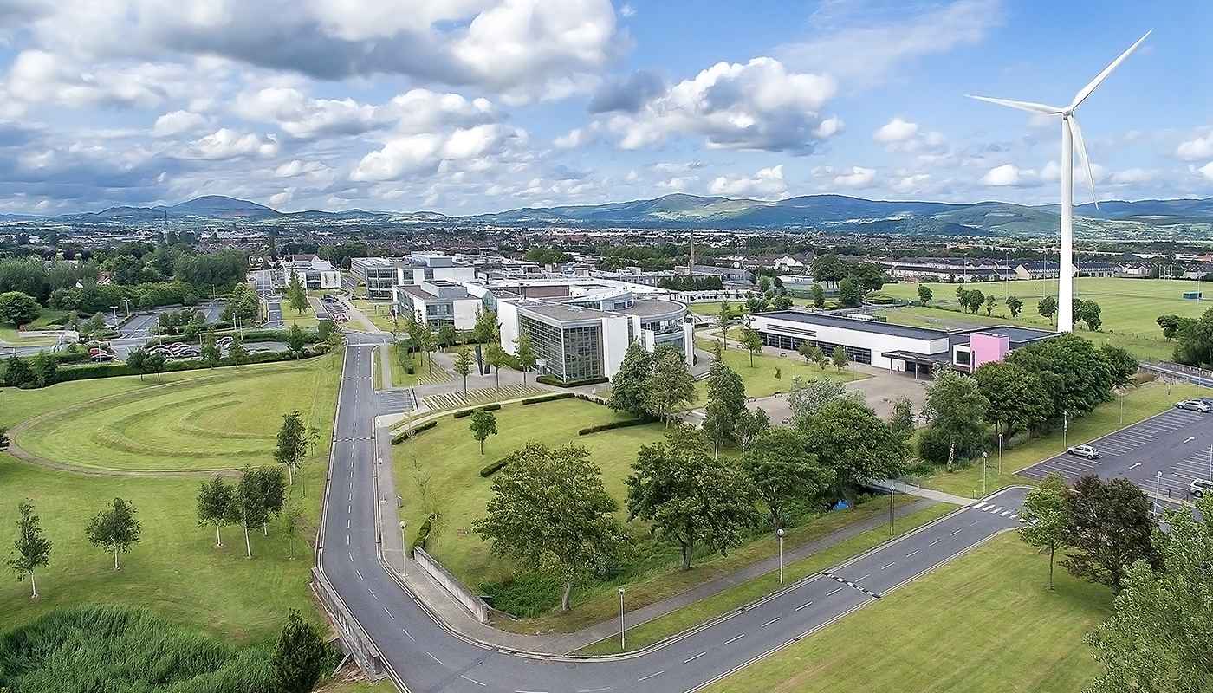
Support & Advice
Daniel Riordan and the IMAR Technology Gateway team @IT Tralee offered free technology consultations to local businesses
Treasa Fox, Head of AIT Student Counselling Services offered valuable advice on “coping with Covid”
DkIT opened a drive-thru testing facility on campus

Slide 6
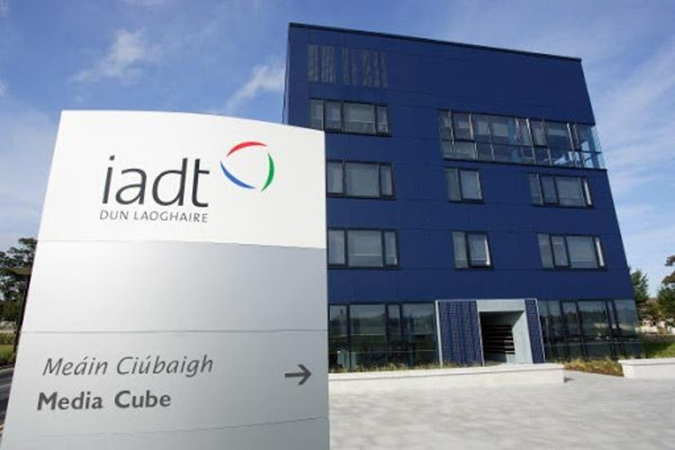
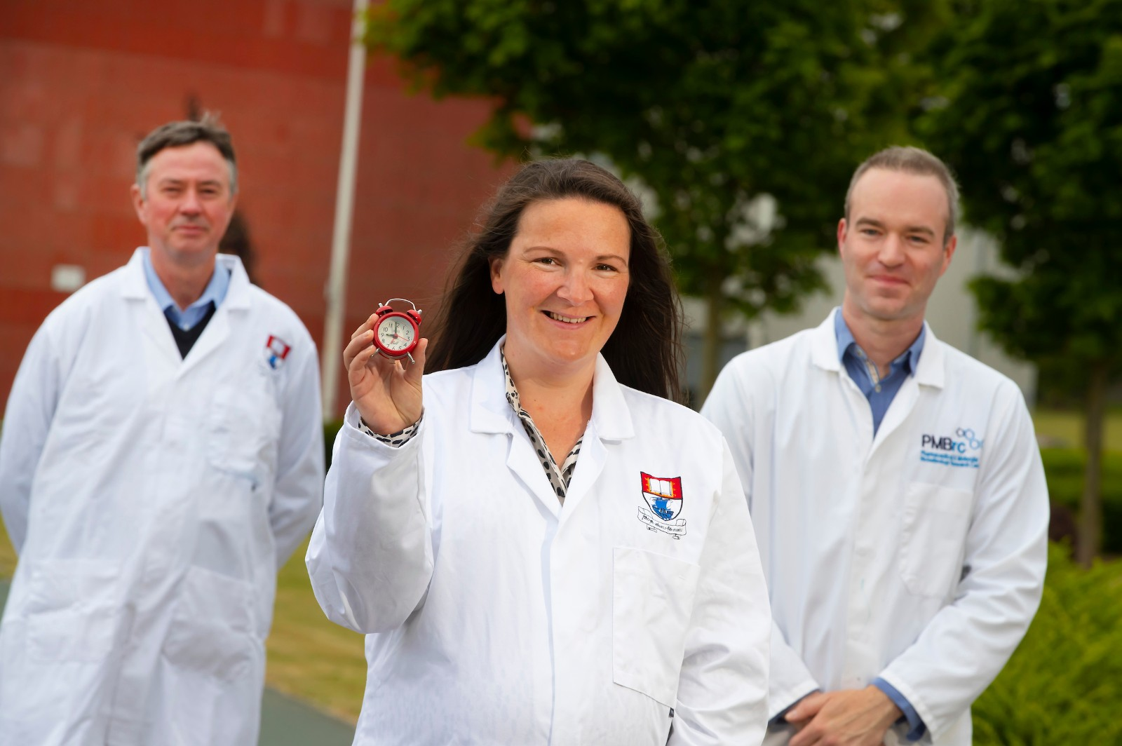
Innovative Technologies
Companies in the IADT Campus Incubator developed new technologies to assist with the pandemic. Zendra Health developed a novel self-screening mobile app for use in nursing homes
Scientists from WIT received SFI funding to work with University Hospital Waterford and WIT-spin out BioEnz Technologies Ltd. to improve the speed of COVID-19 testing

Slide 7
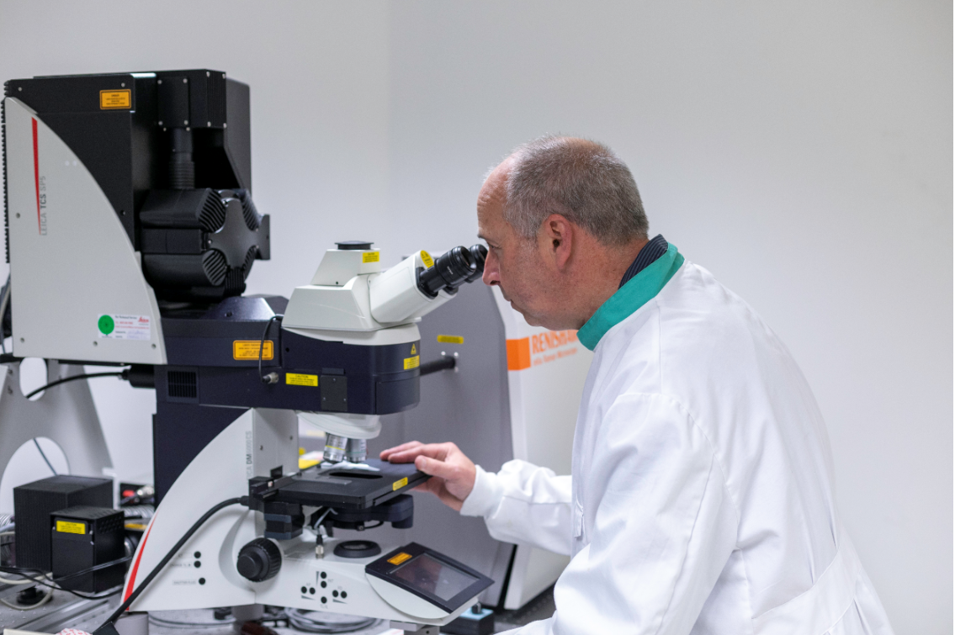
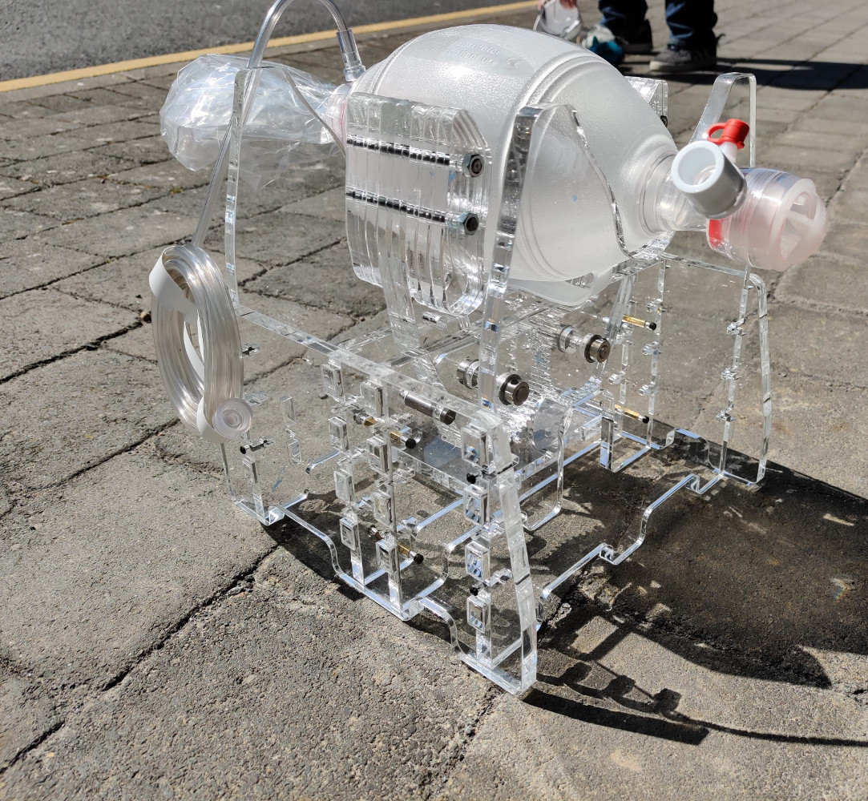
Innovative Technologies
Prof. Neil Rowan from AIT is collaborating with NUIG on a project to explore ways to decontaminate PPE without destroying it, so it can be reused
Staff from the GMIT School of Engineering developed a new type of quick-assembly emergency ventilator

Slide 8
http://www.thea.ie/covid-19-helping/

